Slide 1
ADVANCED REGRESSION MODELS WITH R APPLICATIONS by Olga Korosteleva, Ph.D. CSULB Southern California R User Group October 1, 2022

Slide 2

ABOUT ME
BS in Mathematics, Wayne State University, Detroit, MI, 1996
MS in Statistics, Purdue University, West Lafayette, IN, 1998
Ph.D. in Statistics, Purdue University, West Lafayette, IN, 2002
Professor of Statistics, CSU, Long Beach, 2002-present

Slide 3
OUTLINE
Linear regression for normal response
Gamma regression
Binary logistic regression
Poisson regression
Zero-inflated Poisson regression
Beta regression
Longitudinal normal regression
Generalized longitudinal regression (logistic, Poisson)
Hierarchical normal regression

Slide 4
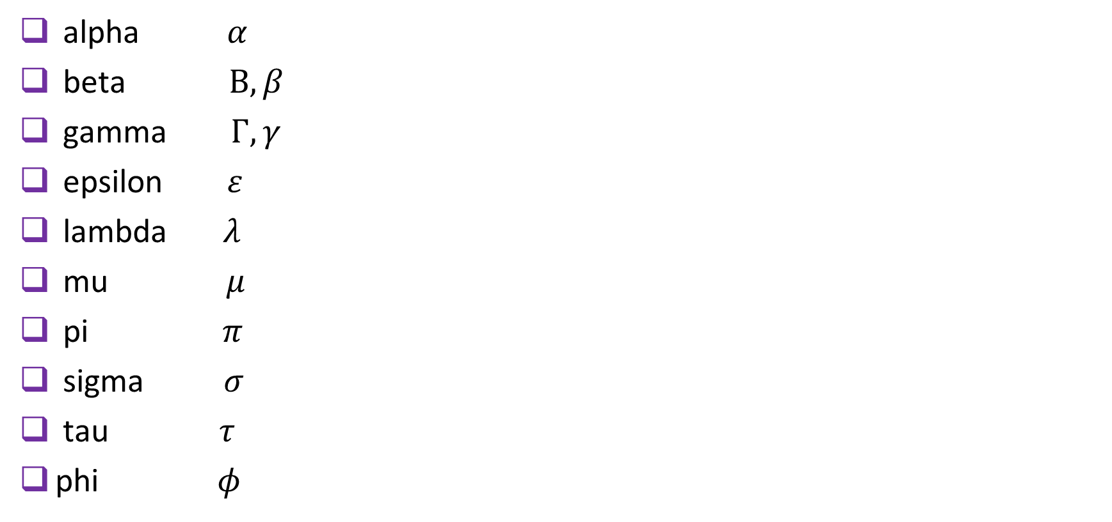
GREEK LETTERS
alpha $α$
beta $B, β$
gamma $Γ, γ$
epsilon $ε$
lambda $λ$
mu $μ$
pi $π$
sigma $σ$
tau $τ$
phi $φ$

Slide 5
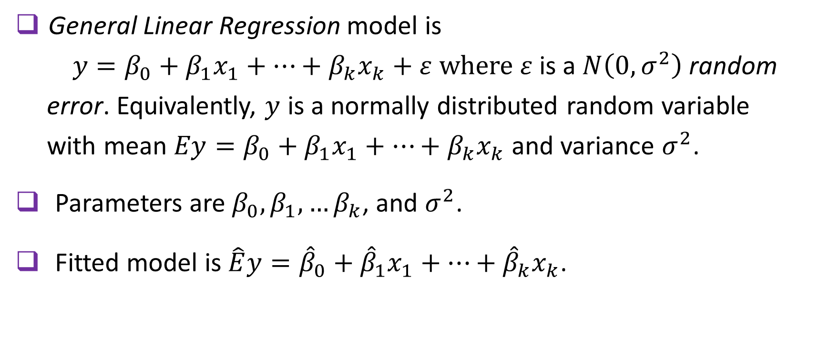
GENERAL LINEAR REGRESSION: OVERVIEW
General Linear Regression model is
$y=β_{0}+{β_{1}x}_{1}+…+{β_{k}x}_{k}+ε$where $ε$ is a $N\left(0,σ^{2}\right)$random
error. Equivalently, $y$ is a normally distributed random variable
with mean $Ey=β_{0}+{β_{1}x}_{1}+…+{β_{k}x}_{k}$ and variance $σ^{2}$.
Parameters are $β_{0},β_{1},…β_{k}$, and $σ^{2}$.
Fitted model is $\hat{E}y={\hat{β}}_{0}+{\hat{β}}_{1}x_{1}+…+{\hat{β}}_{k}x_{k}$.

Slide 6
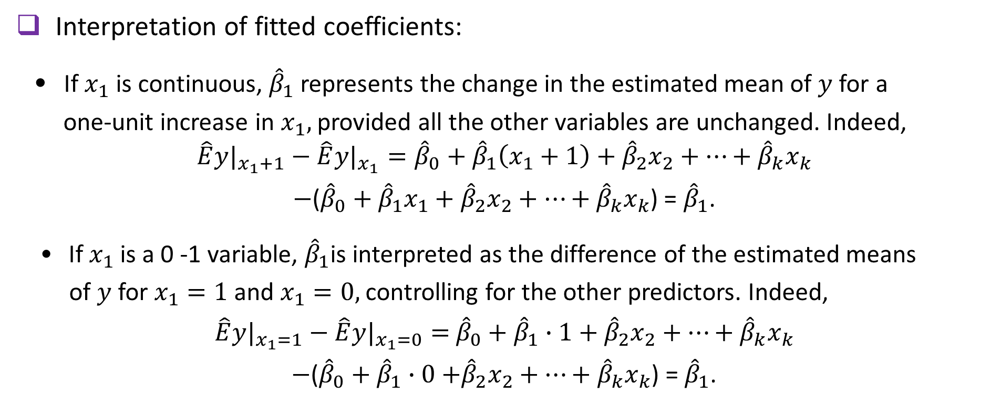
GENERAL Linear regression: Overview (cont.)
Interpretation of fitted coefficients:
• If $x_{1}$ is continuous, ${\hat{β}}_{1}$represents the change in the estimated mean of $y$for a
one-unit increase in $x_{1},$provided all the other variables are unchanged. Indeed,
$$\hat{E}{y|}_{x_{1}+1}−\hat{E}{y|}_{x_{1}}={\hat{β}}_{0}+{\hat{β}}_{1}\left(x_{1}+1\right)+{\hat{β}}_{2}x_{2}+…+{\hat{β}}_{k}x_{k}$$
$−$(${\hat{β}}_{0}+{\hat{β}}_{1}x_{1}+{\hat{β}}_{2}x_{2}+…+{\hat{β}}_{k}x_{k}$) = ${\hat{β}}_{1}$.
• If $x_{1}$ is a 0 -1 variable, ${\hat{β}}_{1}$is interpreted as the difference of the estimated means
of $y$ for $x_{1}=1$ and $x_{1}=0,$controlling for the other predictors. Indeed,
$\hat{E}{y|}_{x_{1}=1}−\hat{E}{y|}_{x_{1}=0}=$ ${\hat{β}}_{0}+{\hat{β}}_{1}∙1+{\hat{β}}_{2}x_{2}+…+{\hat{β}}_{k}x_{k}$
$−$(${\hat{β}}_{0}+{\hat{β}}_{1}∙0$ $+{\hat{β}}_{2}x_{2}+…+{\hat{β}}_{k}x_{k}$) = ${\hat{β}}_{1}$.

Slide 7
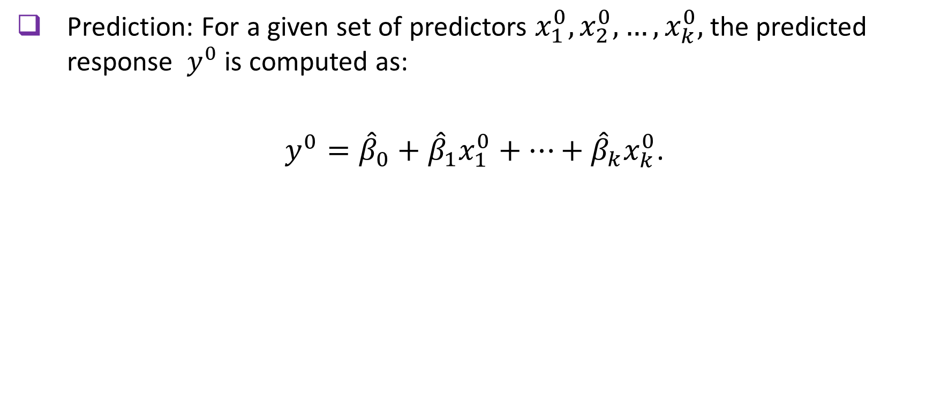
GENERAL Linear regression: Overview (cont.)
Prediction: For a given set of predictors $x_{1}^{0}, x_{2}^{0}, …, x_{k}^{0},$the predicted response $y^{0}$ is computed as:
$y^{0}={\hat{β}}_{0}+{\hat{β}}_{1}x_{1}^{0}+…+{\hat{β}}_{k}x_{k}^{0}$.

Slide 8
General Linear regression: EXAMPLE
A survey of 48 employees of a large company was conducted with the purpose of determining how satisfied they are with their jobs. Such demographic variables as gender, age, and education (Bachelor, Master, or Doctoral degree) were recorded. The total satisfaction score was calculated as a sum of scores on 20 questions on a 5-point Likert scale. We use these data to develop a regression model that relates the job satisfaction score to the other variables.

Slide 9
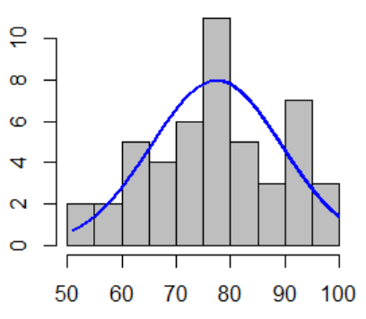
General Linear regression: EXAMPLE
First, we plot the histogram for the scores.
job.satisfaction.data<- read.csv(file="./NormalExampleData.csv", header=TRUE, sep=",")
install.packages("rcompanion")
library(rcompanion)
plotNormalHistogram(job.satisfaction.data$score)
9

Slide 10
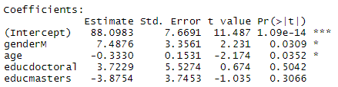
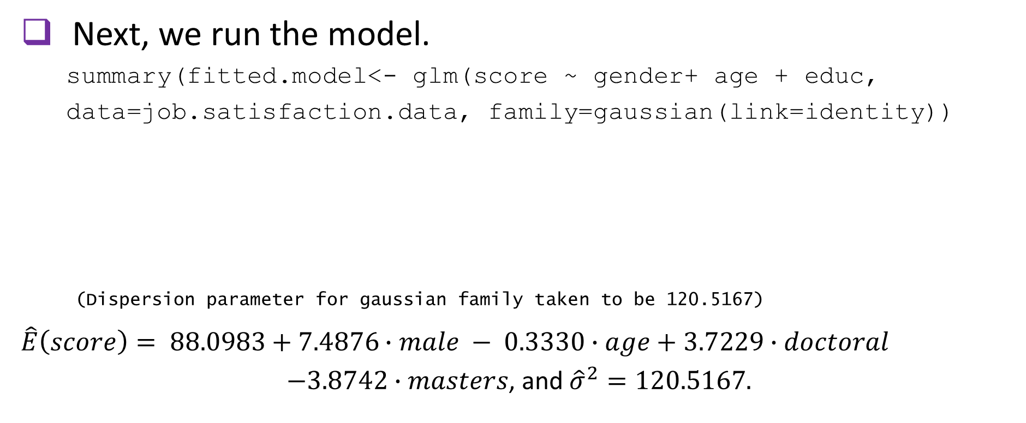
General Linear regression: EXAMPLE (cont.)
Next, we run the model.
summary(fitted.model<- glm(score ~ gender+ age + educ,
data=job.satisfaction.data, family=gaussian(link=identity))
(Dispersion parameter for gaussian family taken to be 120.5167)
$$\hat{E}\left(score\right)= 88.0983+7.4876∙male − 0.3330∙age+3.7229∙doctoral$$
$−3.8742∙masters$, and ${\hat{σ}}^{2}=120.5167.$
10

Slide 11
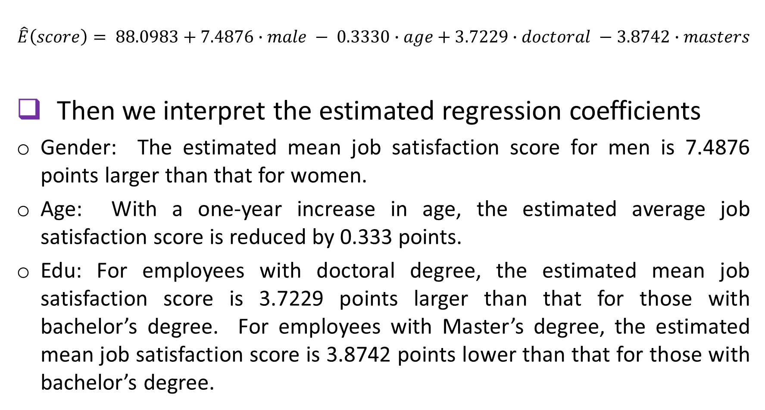
General Linear regression: EXAMPLE (cont.)
$$\hat{E}\left(score\right)= 88.0983+7.4876∙male − 0.3330∙age+3.7229∙doctoral −3.8742∙masters$$
Then we interpret the estimated regression coefficients
Gender: The estimated mean job satisfaction score for men is 7.4876 points larger than that for women.
Age: With a one-year increase in age, the estimated average job satisfaction score is reduced by 0.333 points.
Edu: For employees with doctoral degree, the estimated mean job satisfaction score is 3.7229 points larger than that for those with bachelor’s degree. For employees with Master’s degree, the estimated mean job satisfaction score is 3.8742 points lower than that for those with bachelor’s degree.
11

Slide 12
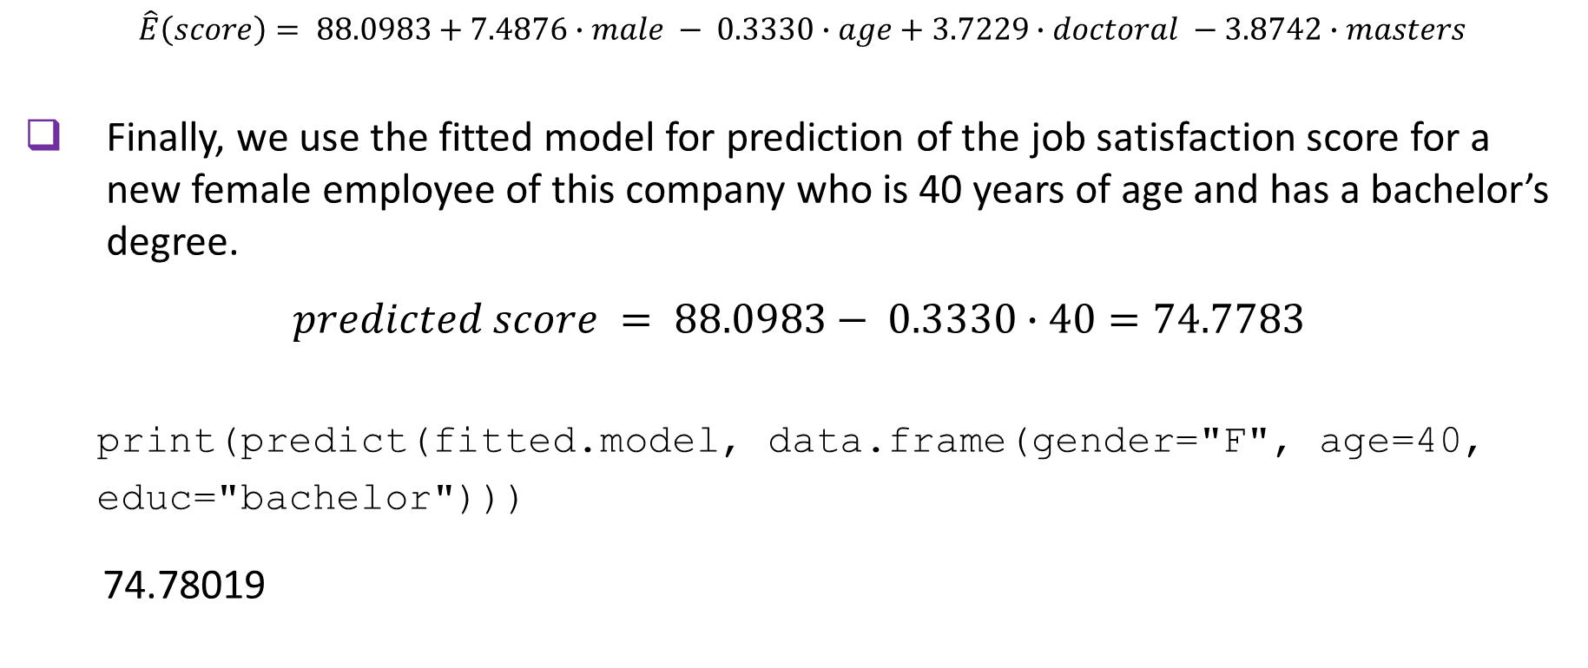
General Linear regression: EXAMPLE (cont.)
$\hat{E}\left(score\right)= 88.0983+7.4876∙male − 0.3330∙age+3.7229∙doctoral −3.8742∙masters$
Finally, we use the fitted model for prediction of the job satisfaction score for a new female employee of this company who is 40 years of age and has a bachelor’s degree.
$$predicted score = 88.0983− 0.3330∙40=74.7783$$
print(predict(fitted.model, data.frame(gender="F", age=40,
educ="bachelor")))
74.78019
12

Slide 13
General Linear regression: EXERCISE
A cardiologist conducts a study to find out what factors are good predictors of elevated heart rate (HR) in her patients. She measures heart rate at rest in 30 patients on their next visit, and obtains from the medical charts additional data on their age, gender, ethnicity, body mass index (BMI), and the number of currently taken heart medications. She also obtains the air quality index (AQI) for the area of residence of her patients.
13

Slide 14
General Linear regression: EXERCISE (cont.)
(1) Check normality of the heart rate measurements.
(2) Fit the general linear regression model. Write down the fitted model.
(3) Give interpretation of the estimated regression coefficients.
(4) Compute the predicted heart rate of a 50-year-old Hispanic male who has a BMI of 20, is not taking any heart medications, and resides in an area with a moderate air quality.
14

Slide 15
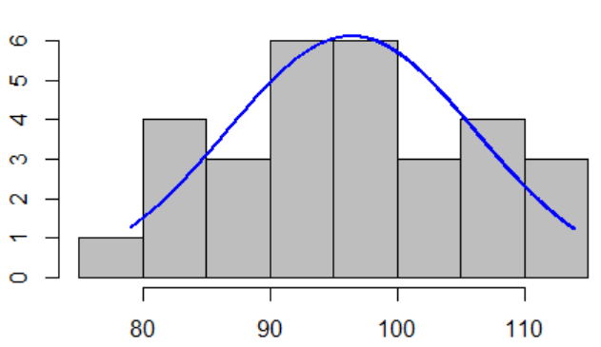
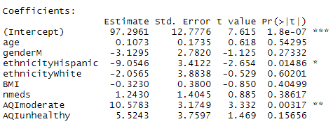
General Linear regression: EXERCISE solution
HR.data<- read.csv(file="./NormalExerciseData.csv", header=TRUE, sep=",")
Construct histogram
library(rcompanion)
plotNormalHistogram(HR.data$HR)
Fit the model
summary(fitted.model<- glm(HR ~ age + gender + ethnicity+BMI
+ nmeds+AQI, data=HR.data, family=gaussian(link=identity)))
(Dispersion parameter for gaussian family taken to be 49.84804)
15

Slide 16
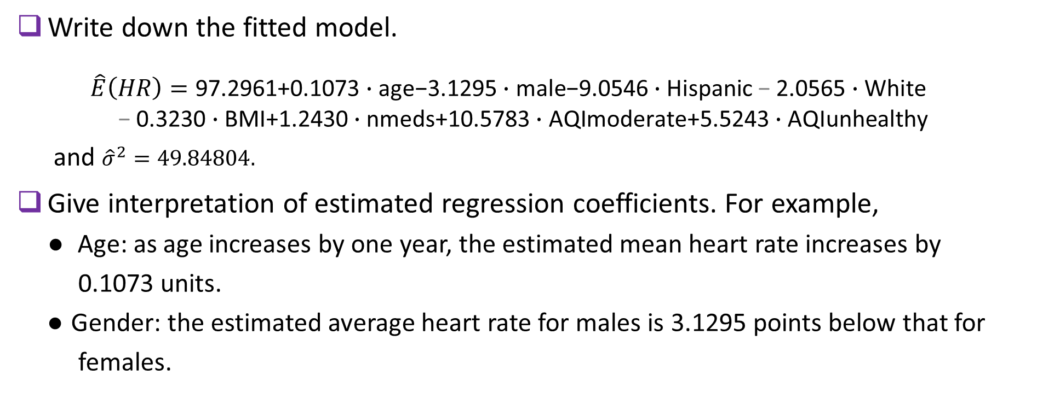
General Linear regression: EXERCISE solution (Cont.)
Write down the fitted model.
$\hat{E}\left(HR\right)=\text{97.2961+0.1073}∙\text{age}\text{−3.1295}∙\text{male}\text{−9.0546}∙\text{Hispanic}\text{ − }\text{2.0565}∙\text{White}$
$$\text{− }\text{0.3230}∙\text{BMI}\text{+1.2430}∙\text{nmeds}\text{+10.5783}∙\text{AQImoderate}\text{+5.5243}∙\text{AQIunhealthy}$$
and ${\hat{σ}}^{2}=49.84804.$
Give interpretation of estimated regression coefficients. For example,
● Age: as age increases by one year, the estimated mean heart rate increases by
0.1073 units.
● Gender: the estimated average heart rate for males is 3.1295 points below that for
females.
16

Slide 17
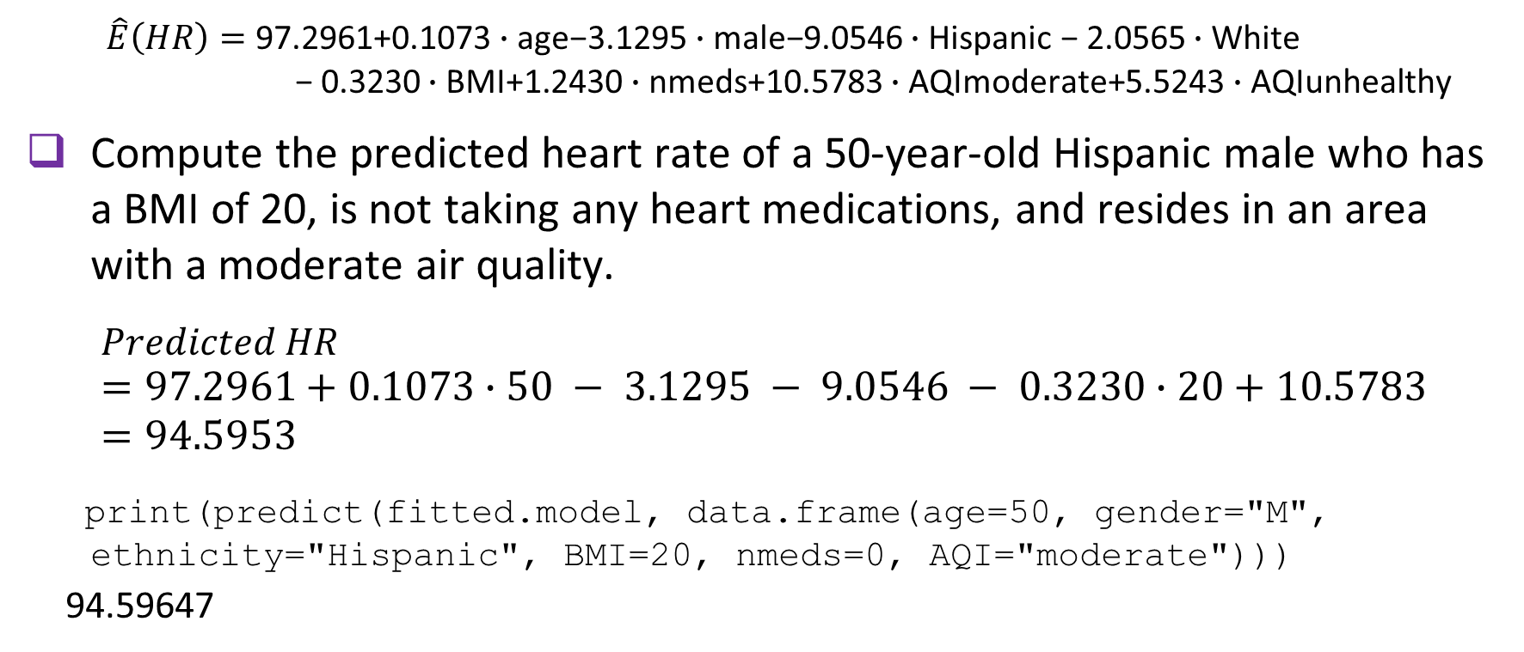
General Linear regression: EXERCISE solution (cont.)
$\hat{E}\left(HR\right)=\text{97.2961+0.1073}∙\text{age}\text{−3.1295}∙\text{male}\text{−9.0546}∙\text{Hispanic}\text{ − 2.0565}∙\text{White}$
$$\text{ − 0.3230}∙\text{BMI}\text{+1.2430}∙\text{nmeds}\text{+10.5783}∙\text{AQImoderate}\text{+5.5243}∙\text{AQIunhealthy}$$
Compute the predicted heart rate of a 50-year-old Hispanic male who has a BMI of 20, is not taking any heart medications, and resides in an area with a moderate air quality.
$$Predicted HR =97.2961+0.1073∙50 − 3.1295 − 9.0546 − 0.3230∙20+10.5783=94.5953$$
print(predict(fitted.model, data.frame(age=50, gender="M",
ethnicity="Hispanic", BMI=20, nmeds=0, AQI="moderate")))
9494.59647
17

Slide 18
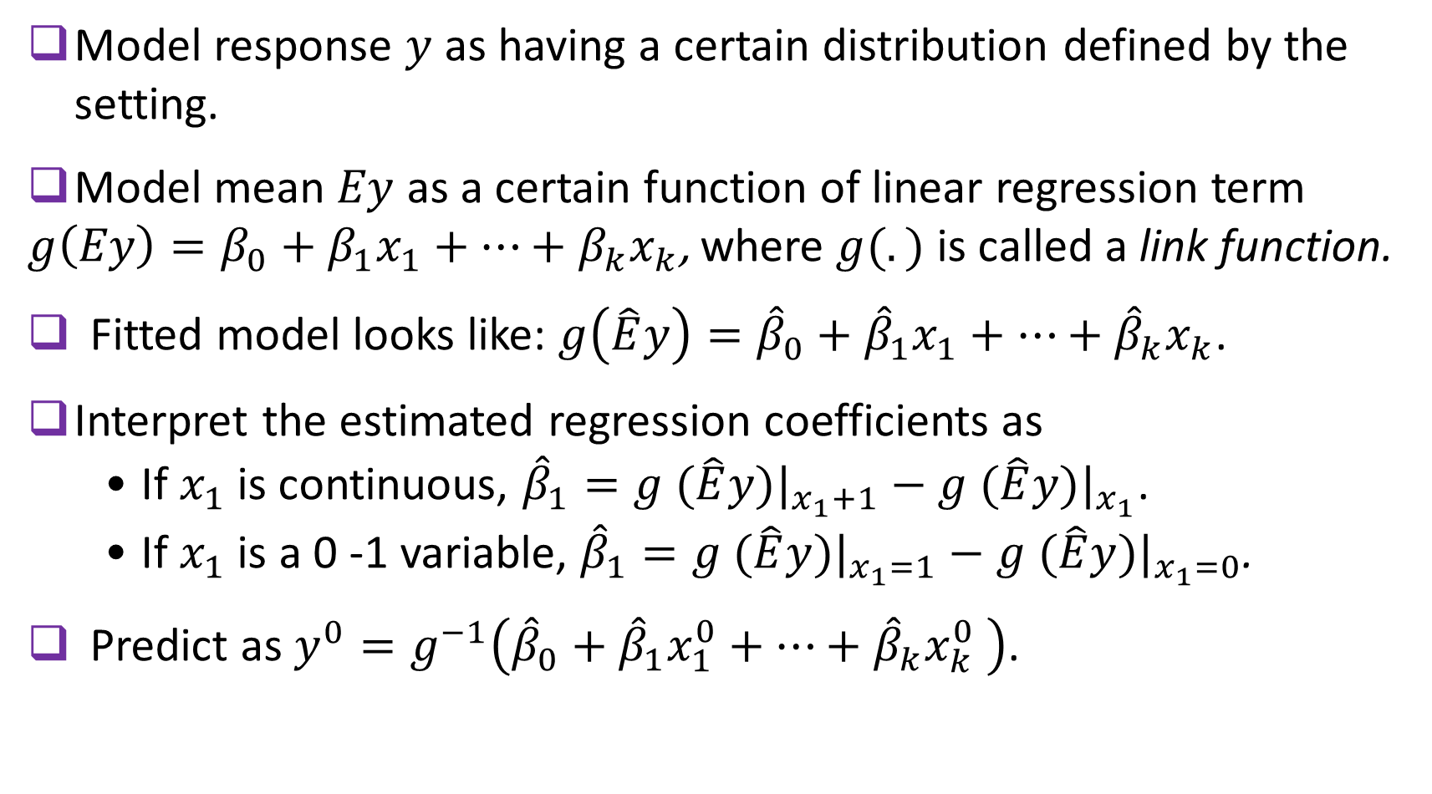
GENERALIZED LINEAR REGRESSION MODELS: THEORY
Model response $y$ as having a certain distribution defined by the setting.
Model mean $Ey$ as a certain function of linear regression term
$g\left(Ey\right)=β_{0}+{β_{1}x}_{1}+…+{β_{k}x}_{k}$, where $g(.)$ is called a link function.
Fitted model looks like: $g\left(\hat{E}y\right)={\hat{β}}_{0}+{\hat{β}}_{1}x_{1}+…+{\hat{β}}_{k}x_{k}$.
Interpret the estimated regression coefficients as
• If $x_{1}$is continuous, ${\hat{β}}_{1}=g (\hat{E}{y)|}_{x_{1}+1}−g (\hat{E}{y)|}_{x_{1}}$.
• If $x_{1}$ is a 0 -1 variable, ${\hat{β}}_{1}=g (\hat{E}{y)|}_{x_{1}=1}−g (\hat{E}{y)|}_{x_{1}=0}$.
Predict as $y^{0}=g^{−1}\left({\hat{β}}_{0}+{\hat{β}}_{1}x_{1}^{0}+…+{\hat{β}}_{k}x_{k}^{0} \right)$.
18

Slide 19
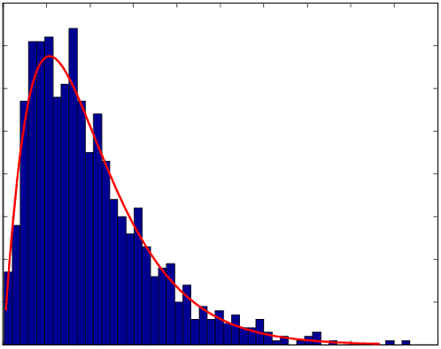
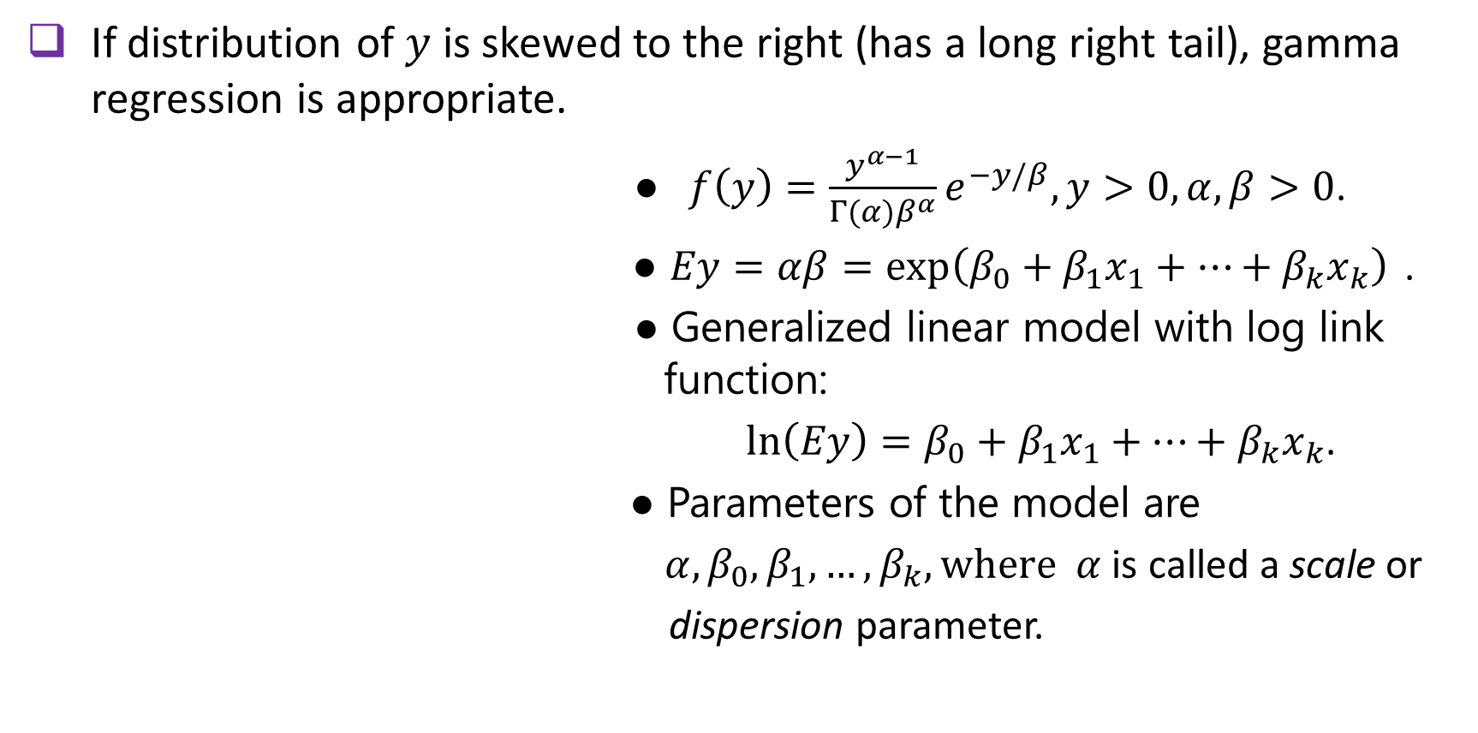
GAMMA REGRESSION MODEL: THEORY
If distribution of $y$ is skewed to the right (has a long right tail), gamma regression is appropriate.
● $f\left(y\right)=\frac{y^{α−1}}{Γ(α)β^{α}}e^{−y/β}, y>0, α, β>0$.
● $Ey=αβ=\exp\left(β_{0}+β_{1}x_{1}+…+β_{k}x_{k}\right)⁡$.
● Generalized linear model with log link function:
$\ln\left(Ey\right)=β_{0}+β_{1}x_{1}+…+β_{k}x_{k}$.
● Parameters of the model are
$α,β_{0}, β_{1}, …, β_{k}, where α$ is called a scale or
dispersion parameter.
19

Slide 20
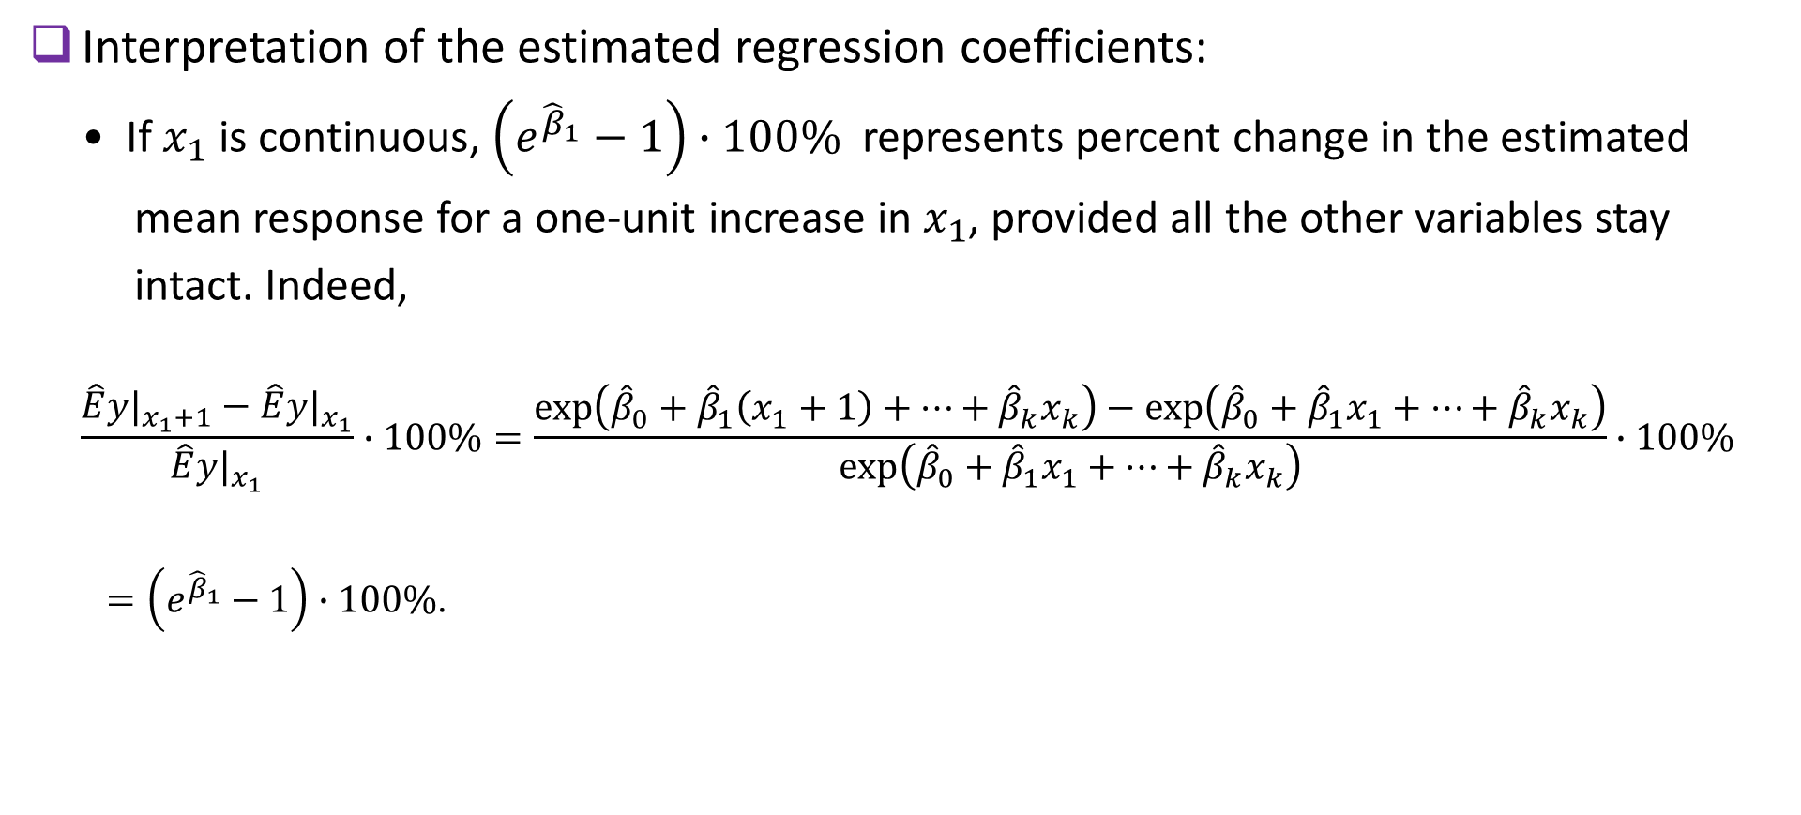
GAMMA REGRESSION MODEL: THEORY (cont.)
Interpretation of the estimated regression coefficients:
• If $x_{1}$ is continuous, $\left(e^{{\hat{β}}_{1}}−1\right)∙100\%$ represents percent change in the estimated
mean response for a one-unit increase in $x_{1}$, provided all the other variables stay
intact. Indeed,
$$\frac{\hat{E}y|_{x_{1}+1}−\hat{E}y|_{x_{1}}}{\hat{E}y|_{x_{1}}}∙100\%=\frac{\exp\left({\hat{β}}_{0}+{\hat{β}}_{1}\left(x_{1}+1\right)+…+{\hat{β}}_{k}x_{k}\right)−\exp\left({\hat{β}}_{0}+{\hat{β}}_{1}x_{1}+…+{\hat{β}}_{k}x_{k}\right)}{\exp\left({\hat{β}}_{0}+{\hat{β}}_{1}x_{1}+…+{\hat{β}}_{k}x_{k}\right)}∙100\%$$
$=\left(e^{{\hat{β}}_{1}}−1\right)∙100\%$.
20

Slide 21
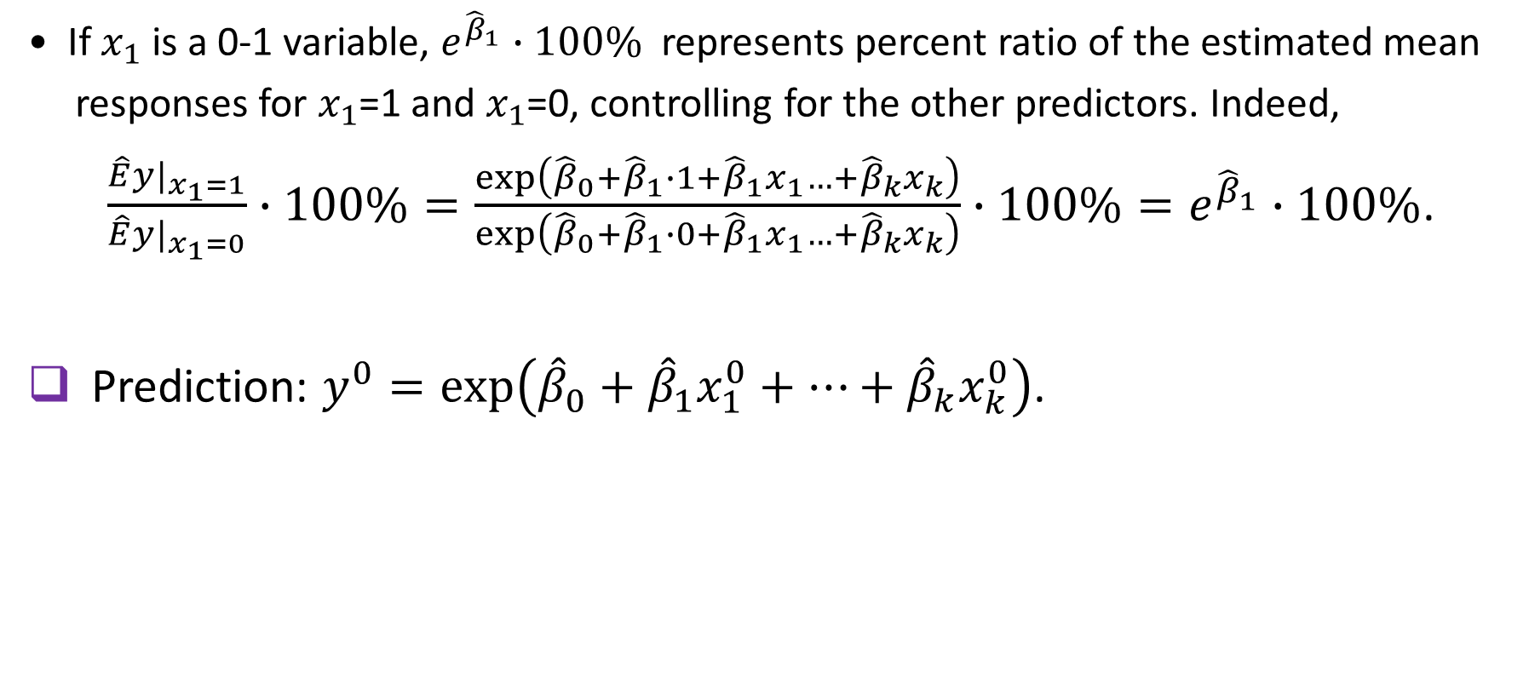
GAMMA REGRESSION MODEL: theory (cont.)
• If $x_{1}$ is a 0-1 variable, $e^{{\hat{β}}_{1}}∙100\%$ represents percent ratio of the estimated mean
responses for $x_{1}$=1 and $x_{1}$=0, controlling for the other predictors. Indeed,
$\frac{\hat{E}y|_{x_{1}=1}}{\hat{E}y|_{x_{1}=0}}∙100\%=\frac{\exp\left({\hat{β}}_{0}+{\hat{β}}_{1}∙1+{\hat{β}}_{1}x_{1}…+{\hat{β}}_{k}x_{k}\right)}{\exp\left({\hat{β}}_{0}+{\hat{β}}_{1}∙0+{\hat{β}}_{1}x_{1}…+{\hat{β}}_{k}x_{k}\right)}∙100\%=e^{{\hat{β}}_{1}}∙100\%$.
Prediction: $y^{0}=\exp\left({\hat{β}}_{0}+{\hat{β}}_{1}x_{1}^{0}+…+{\hat{β}}_{k}x_{k}^{0}\right)$.
21

Slide 22
GAMMA REGRESSION MODEL: EXAMPLE
A real estate specialist is interested in modeling house prices in a certain U.S. region. He suspects that house prices depend on such characteristics as the number of bedrooms, number of bathrooms, square footage of the house, type of heating (central/electrical/none), presence of air conditioner (A/C) (yes/no), and lot size. He obtains the data on 30 houses currently on the market.
22

Slide 23
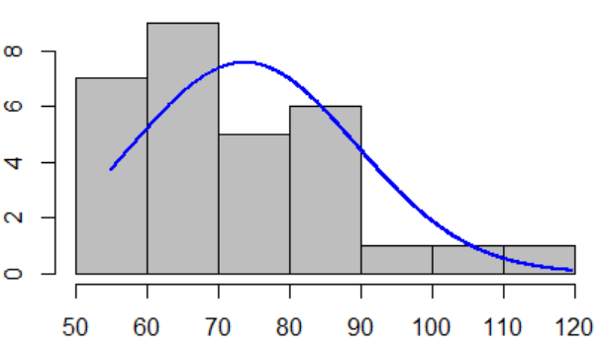
GAMMA REGRESSION MODEL: EXAMPLE (CONT.)
Construct histogram for house prices.
real.estate.data<- read.csv(file="./GammaExampleData.csv",
header=TRUE, sep=",")
#rescaling variables
price10K<- real.estate.data$price/10000
sqftK<-real.estate.data$sqft/1000
lotsizeK<-real.estate.data$lotsize/1000
#plotting histogram with fitted normal density
library(rcompanion)
plotNormalHistogram(price10K)
23

Slide 24
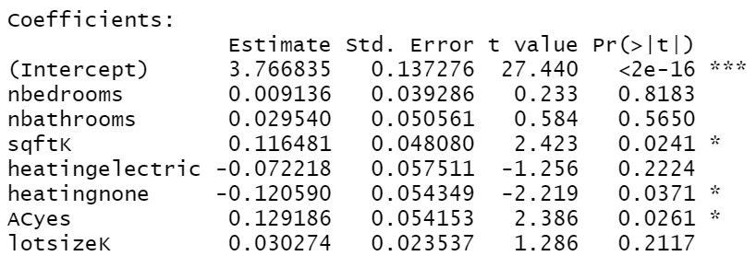
GAMMA REGRESSION MODEL: EXAMPLE (CONT.)
Fit a gamma regression model.
summary(fitted.model<- glm(price10K ~ nbedrooms + nbathrooms + sqftK + heating.rel + AC.rel + lotsizeK, data=real.estate.data, family=Gamma(link=log)))
24

Slide 25
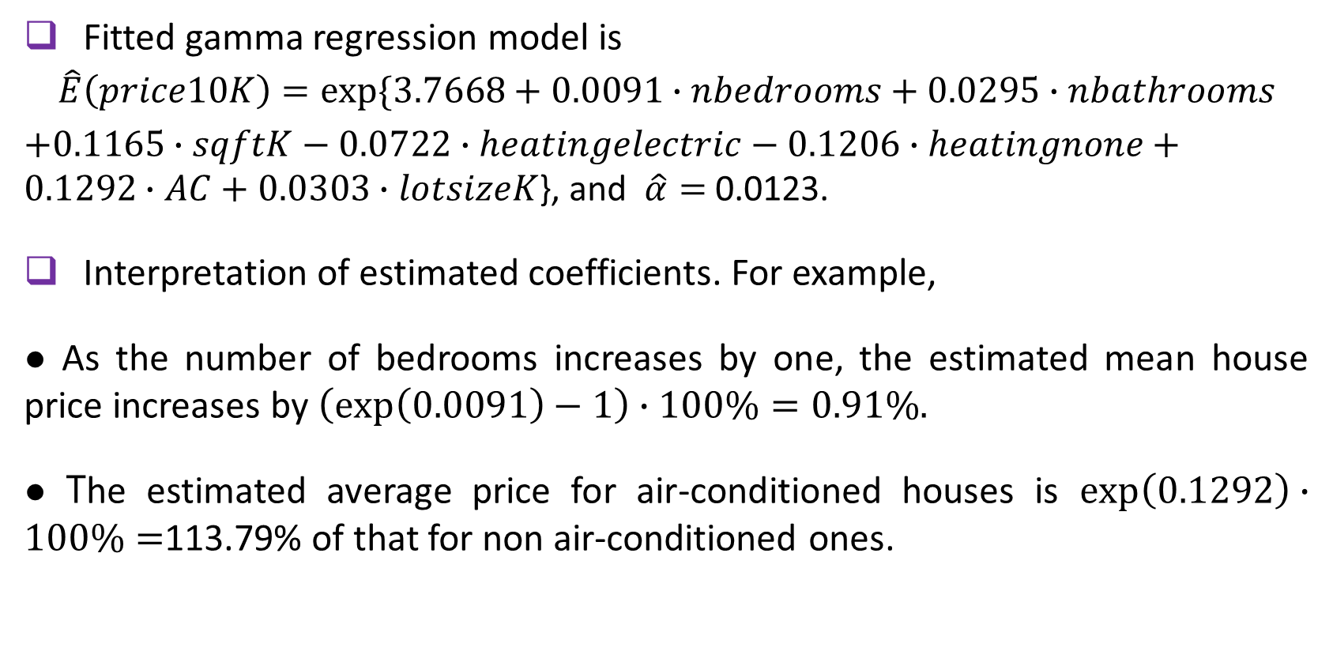
GAMMA REGRESSION MODEL: EXAMPLE (CONT.)
Fitted gamma regression model is
$$\hat{E}\left(price10K\right)=exp⁡\{3.7668+0.0091∙nbedrooms+0.0295∙nbathrooms$$
$+0.1165∙sqftK−0.0722∙heatingelectric−0.1206∙heatingnone+0.1292∙AC+$ $0.0303∙lotsizeK$}, and $\hat{α}=$ 0.0123.
Interpretation of estimated coefficients. For example,
● As the number of bedrooms increases by one, the estimated mean house price increases by $\left(\exp\left(0.0091\right)−1\right)∙100\%=0.91\%.$
● The estimated average price for air-conditioned houses is $\exp\left(0.1292\right)∙100\%=$113.79% of that for non air-conditioned ones.
25

Slide 26
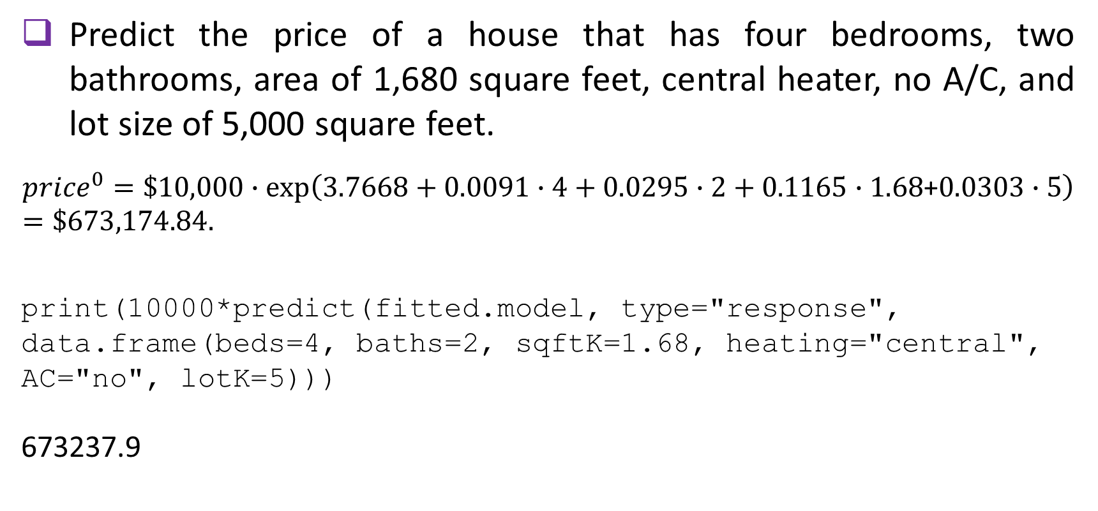
GAMMA REGRESSION MODEL: EXAMPLE (CONT.)
Predict the price of a house that has four bedrooms, two bathrooms, area of 1,680 square feet, central heater, no A/C, and lot size of 5,000 square feet.
$${price}^{0}=\$10,000∙\exp\left(3.7668+0.0091∙4+0.0295∙2+0.1165∙1.68\text{+}0.0303∙5\right)=\$673,174.84.$$
print(10000*predict(fitted.model, type="response", data.frame(beds=4, baths=2, sqftK=1.68, heating="central", AC="no", lotK=5)))
673237.9
26

Slide 27
GAMMA REGRESSION MODEL: EXERCISE
Investigators at a large medical center conducted a quality improvement (QI) study which consisted of a six-month-long series of seminars and practical instructional tools on how to improve quality assurance for future projects at this center. Data were collected on participants' designation (nurse/doctor/staff), years of work at the center, whether had a prior experience with QI projects, and the score on the knowledge and attitude test taken at the end of the study. The score was constructed as the sum of 20 questions on a 5-point Likert scale, thus potentially ranging between 20 and 100. The large value indicates better knowledge about QI and more confidence and desire to use it in upcoming projects. The data on 45 study participants are available.
27

Slide 28
GAMMA REGRESSION MODEL: EXERCISE (cont.)
(1) Check that the distribution of the response variable is right-skewed.
(2) Fit a gamma regression model. Write down the fitted model.
(3) Give interpretation of the estimated regression coefficients.
(4) Predict the score for a nurse who has worked at the center for seven years and who had previously been a co-PI on a grant that involved quality assurance component.
28

Slide 29
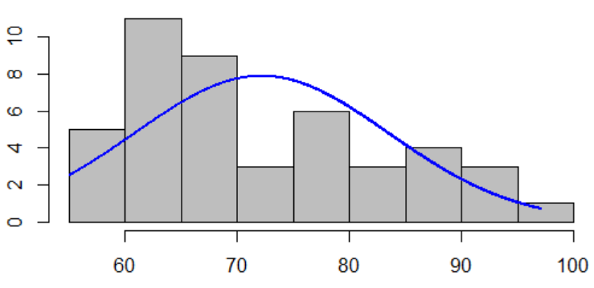
GAMMA REGRESSION MODEL: EXERCISE SOLUTION
QIscore.data<- read.csv(file="./GammaExerciseData.csv", header=TRUE, sep=",")
Construct a histogram.
install.packages("rcompanion")
library(rcompanion)
plotNormalHistogram(QIscore.data$score)
29

Slide 30
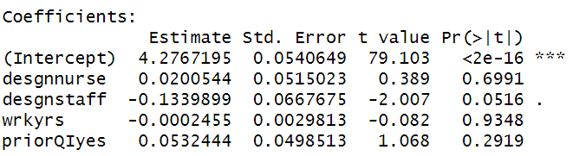
GAMMA REGRESSION MODEL: EXERCISE SOLUTION (cont.)
Fit a gamma regression model.
summary(fitted.model<- glm(score ~ desgn + wrkyrs + priorQI, data=QIscore.data, family=Gamma(link=log)))
30

Slide 31
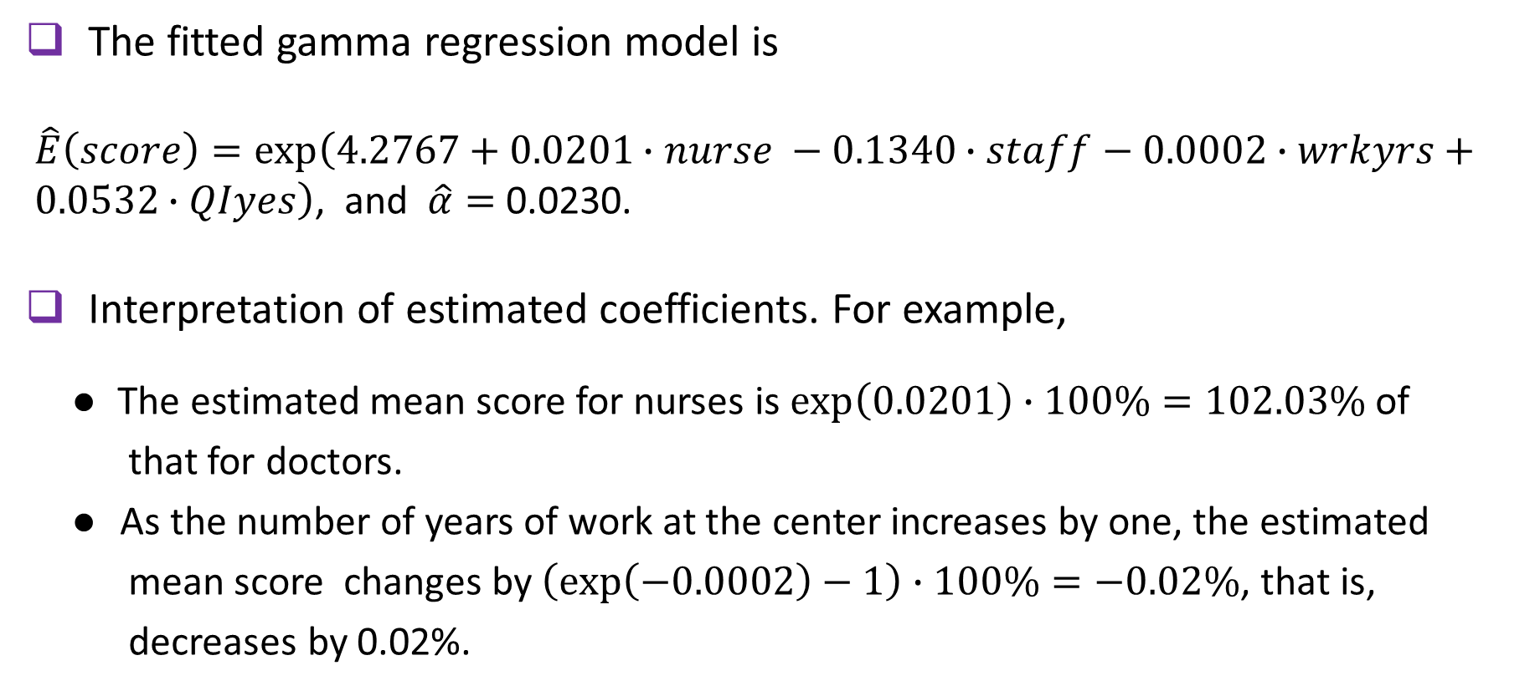
GAMMA REGRESSION MODEL: EXERCISE SOLUTION (cont.)
The fitted gamma regression model is
$\hat{E}\left(score\right)=\exp\left(4.2767+0.0201∙nurse −0.1340∙staff−0.0002∙wrkyrs+ 0.0532∙QIyes\right)$, and $\hat{α}=$ 0.0230.
Interpretation of estimated coefficients. For example,
● The estimated mean score for nurses is $\exp\left(0.0201\right)∙100\%=102.03\%$ of
that for doctors.
● As the number of years of work at the center increases by one, the estimated
mean score changes by $\left(\exp\left(−0.0002\right)−1\right)∙100\%=−0.02\%$, that is,
decreases by 0.02%.
31

Slide 32
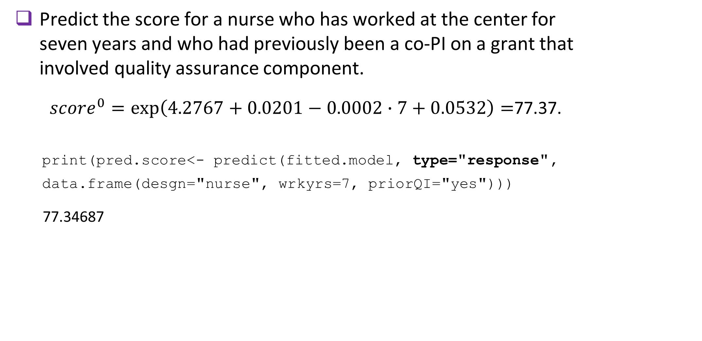
GAMMA REGRESSION MODEL: EXERCISE SOLUTION (cont.)
Predict the score for a nurse who has worked at the center for seven years and who had previously been a co-PI on a grant that involved quality assurance component.
${score}^{0}=\exp\left(4.2767+0.0201−0.0002∙7+0.0532\right)=$77.37.
print(pred.score<- predict(fitted.model, type="response",
data.frame(desgn="nurse", wrkyrs=7, priorQI="yes")))
77.34687
32

Slide 33
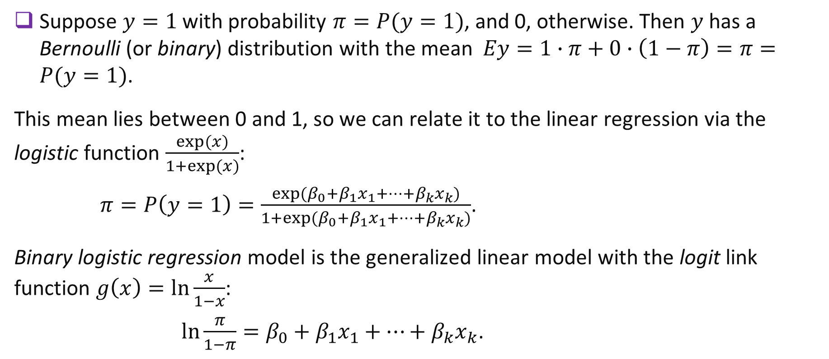
BINARY LOGISTIC REGRESSION MODEL: THEORY
Suppose $y=1$ with probability $π=P(y=1)$, and 0, otherwise. Then $y$ has a Bernoulli (or binary) distribution with the mean $Ey=1∙π+0∙\left(1−π\right)=π=P(y=1)$.
This mean lies between 0 and 1, so we can relate it to the linear regression via the logistic function $\frac{exp⁡(x)}{1+exp⁡(x)}$:
$π=P\left(y=1\right)=\frac{exp(β_{0}+{β_{1}x}_{1}+…+{β_{k}x}_{k})}{1+exp(β_{0}+{β_{1}x}_{1}+…+{β_{k}x}_{k})}$.
Binary logistic regression model is the generalized linear model with the logit link function $g\left(x\right)=\ln{\frac{x}{1−x}}$:
$\ln{\frac{π}{1−π}}=β_{0}+{β_{1}x}_{1}+…+{β_{k}x}_{k}$.
33

Slide 34
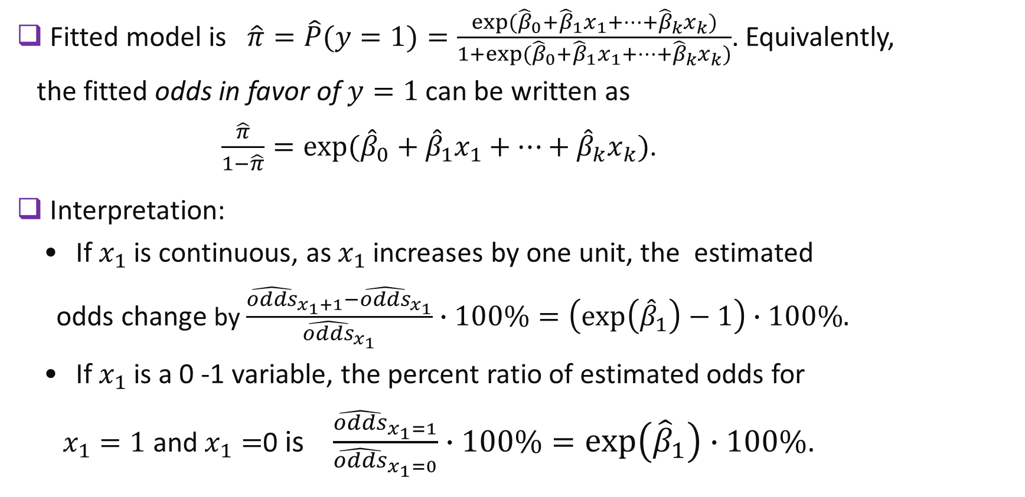
BINARY LOGISTIC REGRESSION EXAMPLE CONTINUES
BINARY LOGISTIC REGRESSION MODEL: THEORY (cont.)
Fitted model is $\hat{π}=\hat{P}(y=1)=\frac{\exp{({\hat{β}}_{0}+{\hat{β}}_{1}x_{1}+…+{\hat{β}}_{k}x_{k})}}{1+\exp{({\hat{β}}_{0}+{\hat{β}}_{1}x_{1}+…+{\hat{β}}_{k}x_{k})}}$. Equivalently,
the fitted odds in favor of $y=1$ can be written as
$\frac{\hat{π}}{1−\hat{π}}=\exp{({\hat{β}}_{0}+{\hat{β}}_{1}x_{1}+…+{\hat{β}}_{k}x_{k})}$.
Interpretation:
• If $x_{1}$ is continuous, as $x_{1}$ increases by one unit, the estimated
odds change by $\frac{{\hat{odds}}_{x_{1}+1}−{\hat{odds}}_{x_{1}}}{{\hat{odds}}_{x_{1}}}∙100\%=\left(\exp\left({\hat{β}}_{1}\right)−1\right)∙100\%.$
• If $x_{1}$ is a 0 -1 variable, the percent ratio of estimated odds for
$x_{1}=1$ and $x_{1}=$0 is $\frac{{\hat{odds}}_{x_{1}=1}}{{\hat{odds}}_{x_{1}=0}}∙100\%=\exp\left({\hat{β}}_{1}\right)∙100\%$.
34

Slide 35
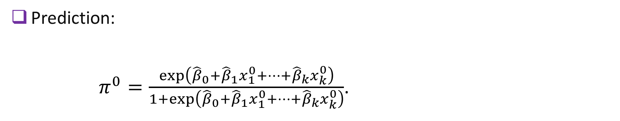
BINARY LOGISTIC REGRESSION MODEL: THEORY (cont.)
Prediction:
$π^{0}=\frac{\exp\left({\hat{β}}_{0}+{\hat{β}}_{1}x_{1}^{0}+…+{\hat{β}}_{k}x_{k}^{0}\right)⁡}{1+\exp\left({\hat{β}}_{0}+{\hat{β}}_{1}x_{1}^{0}+…+{\hat{β}}_{k}x_{k}^{0}\right)}$.
35

Slide 36
BINARY LOGISTIC REGRESSION MODEL: EXAMPLE
A professor of organization and management is interested in studying the factors that influence the approach that company managers
promote among their employees, competition or collaboration. The
data on 50 companies are collected. The variables are the type of
company ownership (sole ownership, partnership, or stock company),
the number of employees, and the promoted approach (competition
or collaboration). We model the probability of collaboration via the
binary logistic regression.
36

Slide 37
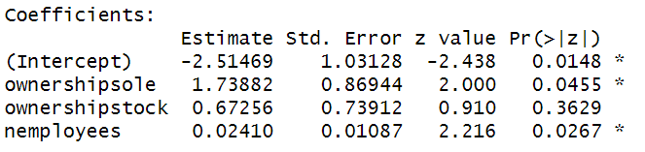
BINARY LOGISTIC REGRESSION MODEL: EXAMPLE (cont.)
companies.data<- read.csv(file="./LogisticExampleData.csv", header=TRUE, sep=",")
Fitting a binary logistic regression model.
#specifying reference category
approach.rel<- relevel(companies.data$approach, ref="comp")
#fitting logistic model
summary(fitted.model<- glm(approach.rel ~ ownership + nemployees,
data=companies.data, family=binomial(link=logit)))
37

Slide 38
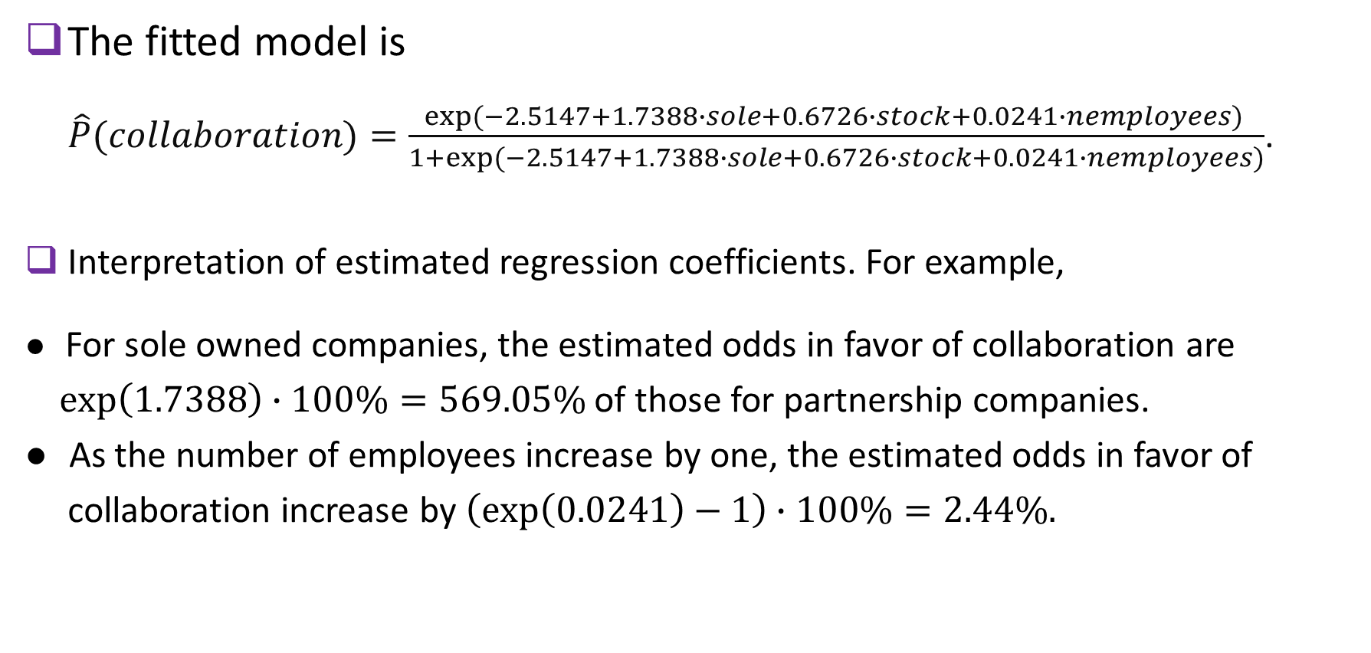
BINARY LOGISTIC REGRESSION MODEL: EXAMPLE (cont.)
The fitted model is
$\hat{P}(collaboration)=\frac{\exp{(−2.5147+1.7388∙sole+0.6726∙stock+0.0241∙nemployees)} }{1+\exp{(−2.5147+1.7388∙sole+0.6726∙stock+0.0241∙nemployees)}}$.
Interpretation of estimated regression coefficients. For example,
● For sole owned companies, the estimated odds in favor of collaboration are
$\exp\left(1.7388\right)$ $∙100\%=569.05\%$ of those for partnership companies.
● As the number of employees increase by one, the estimated odds in favor of
collaboration increase by $\left(\exp\left(0.0241\right)−1\right)∙100\%=2.44\%.$
38

Slide 39
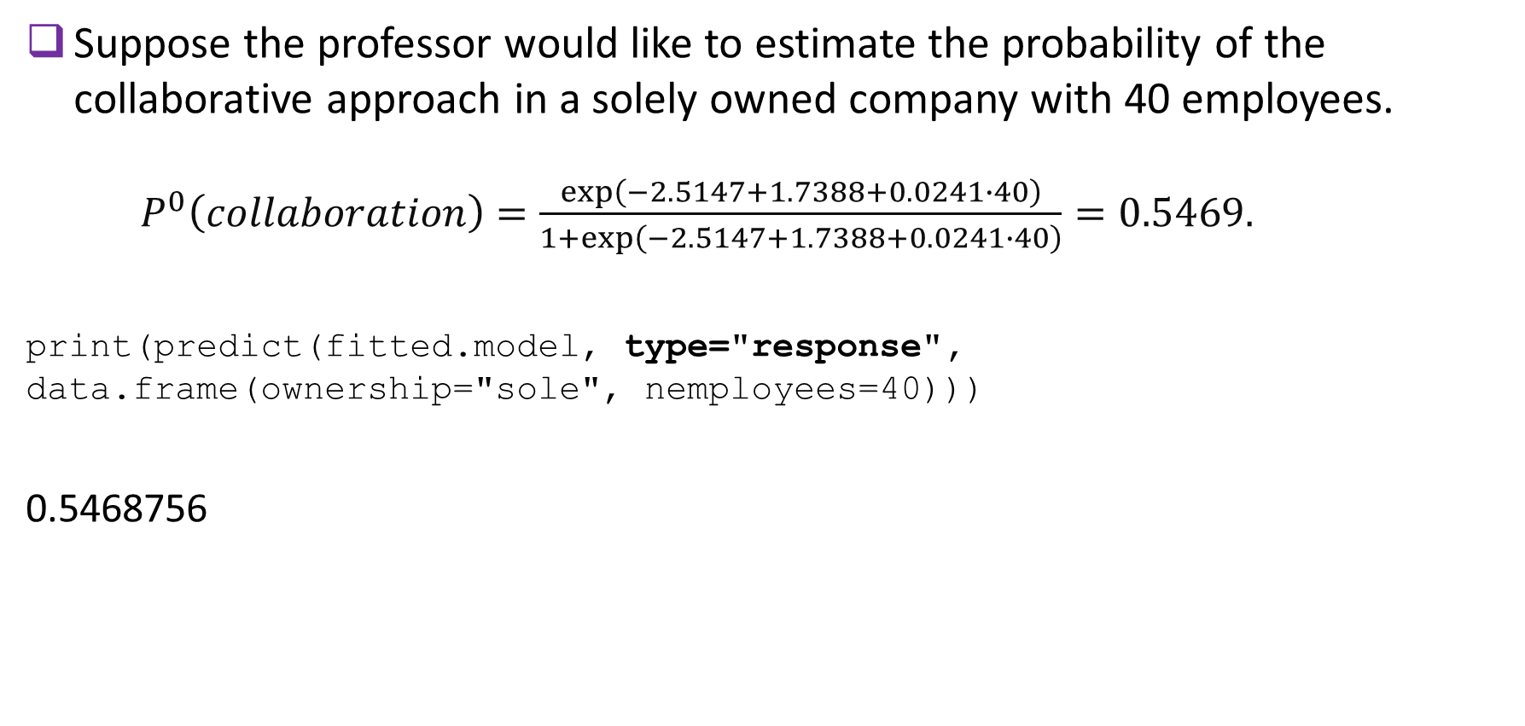
BINARY LOGISTIC REGRESSION MODEL: EXAMPLE (cont.)
Suppose the professor would like to estimate the probability of the collaborative approach in a solely owned company with 40 employees.
$P^{0}\left(collaboration\right)=\frac{\exp\left(−2.5147+1.7388+0.0241∙40\right)}{1+\exp\left(−2.5147+1.7388+0.0241∙40\right)}=0.5469.$
print(predict(fitted.model, type="response", data.frame(ownership="sole", nemployees=40)))
0.5468756
39

Slide 40
BINARY LOGISTIC REGRESSION MODEL: exercise
A bank needs to estimate the default rate of customers' home equity loans. The selected variables are loan-to-value (LTV) ratio defined as the ratio of a loan to the value of an asset purchased (in percent), age (in years), income (high/low), and response (yes=default, no=payoff). The data for 35 customers are available.
(1) Fit a binary logistic regression to model default.
(2) Give interpretation of the estimated regression coefficients.
(3) Find predicted probability of loan default if LTV ratio is 50%, and the borrower is a 50-year old man with high income.
40

Slide 41
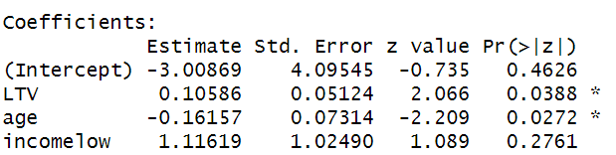
BINARY LOGISTIC REGRESSION MODEL: exercise solution
rate.data<- read.csv(file="./LogisticExerciseData.csv", header=TRUE, sep=",")
Fitting a binary logistic model
#specifying reference category
default.rel<- relevel(rate.data$default, ref="No")
summary(fitted.model.logit<- glm(default.rel~LTV+age+income, data=rate.data, family=binomial(link=logit)))
41

Slide 42
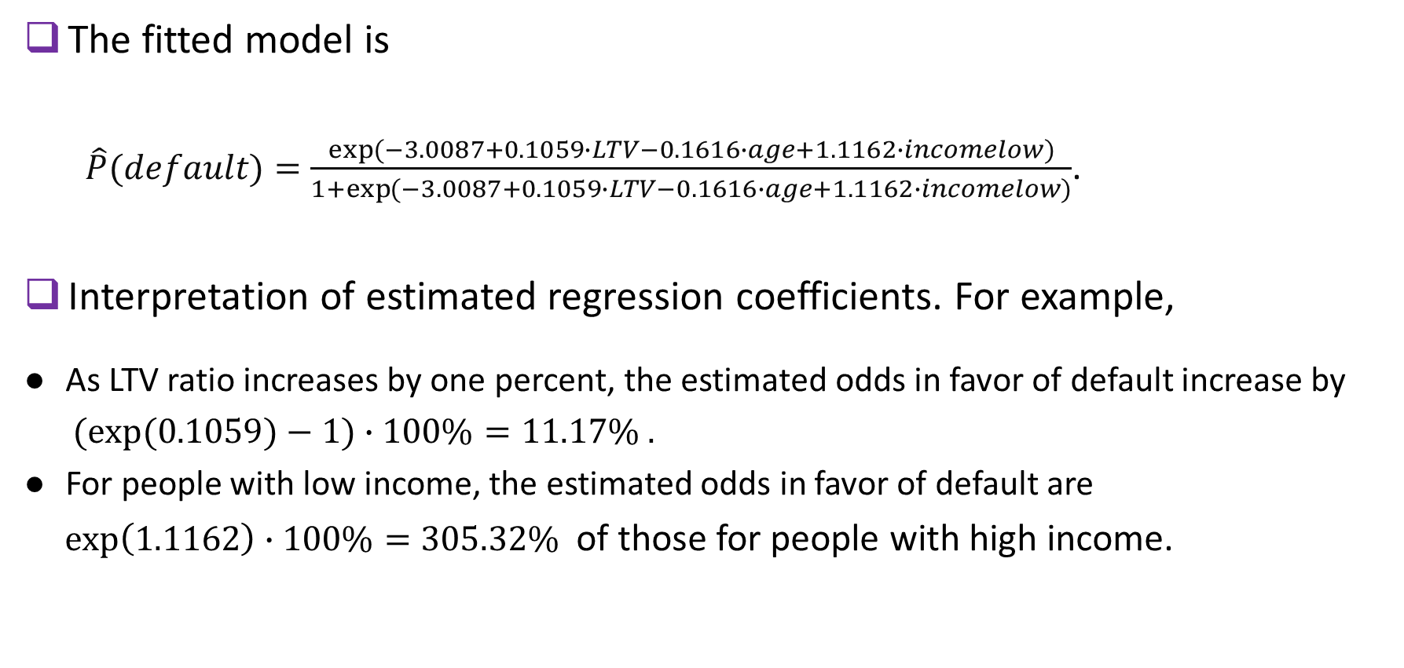
BINARY LOGISTIC REGRESSION MODEL: exercise solution (cont.)
The fitted model is
$\hat{P}(default)=\frac{\exp{(−3.0087+0.1059∙LTV−0.1616∙age+1.1162∙incomelow)}}{1+\exp{(−3.0087+0.1059∙LTV−0.1616∙age+1.1162∙incomelow)}}$.
Interpretation of estimated regression coefficients. For example,
● As LTV ratio increases by one percent, the estimated odds in favor of default increase by
$(exp⁡(0.1059)−1)∙100\%=11.17\% .$
● For people with low income, the estimated odds in favor of default are
$exp⁡\left(1.1162\right)∙100\%=305.32\%$ of those for people with high income.
42

Slide 43
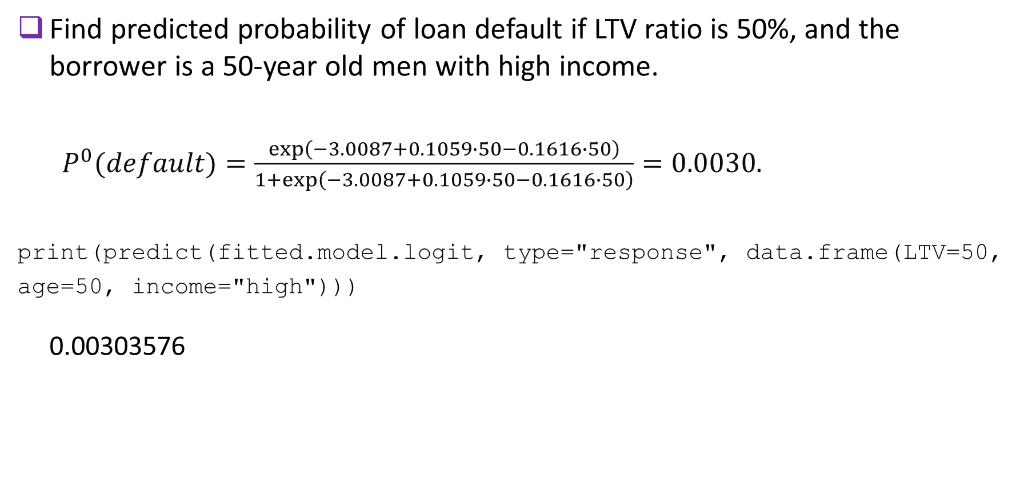
BINARY LOGISTIC REGRESSION MODEL: exercise solution (cont.)
Find predicted probability of loan default if LTV ratio is 50%, and the borrower is a 50-year old men with high income.
$P^{0}(default)=\frac{\exp\left(−3.0087+0.1059∙50−0.1616∙50\right)}{1+\exp\left(−3.0087+0.1059∙50−0.1616∙50\right)}=0.0030.$
print(predict(fitted.model.logit, type="response", data.frame(LTV=50,
age=50, income="high")))
0.00303576
43

Slide 44
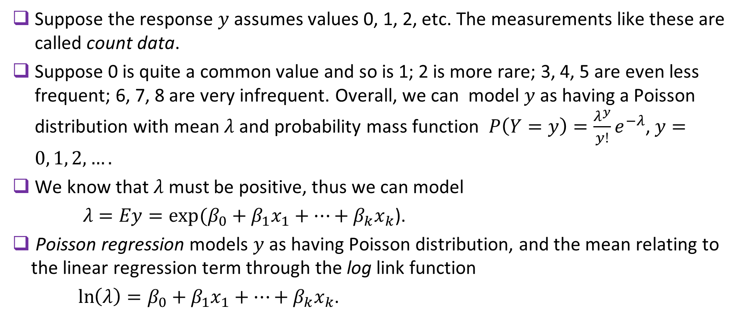
POISSON REGRESSION MODEL: THEORY
Suppose the response $y$assumes values 0, 1, 2, etc. The measurements like these are called count data.
Suppose 0 is quite a common value and so is 1; 2 is more rare; 3, 4, 5 are even less frequent; 6, 7, 8 are very infrequent. Overall, we can model $y$ as having a Poisson distribution with mean $λ$ and probability mass function $P\left(Y=y\right)=\frac{λ^{y}}{y!}e^{−λ}$, $y=0, 1, 2, ….$
We know that $λ$ must be positive, thus we can model
$λ=Ey=\exp{(β_{0}+{β_{1}x}_{1}+…+{β_{k}x}_{k}\text{)}}$.
Poisson regression models $y$ as having Poisson distribution, and the mean relating to the linear regression term through the log link function
$\ln\left(λ\right)=β_{0}+{β_{1}x}_{1}+…+{β_{k}x}_{k}$.
44

Slide 45
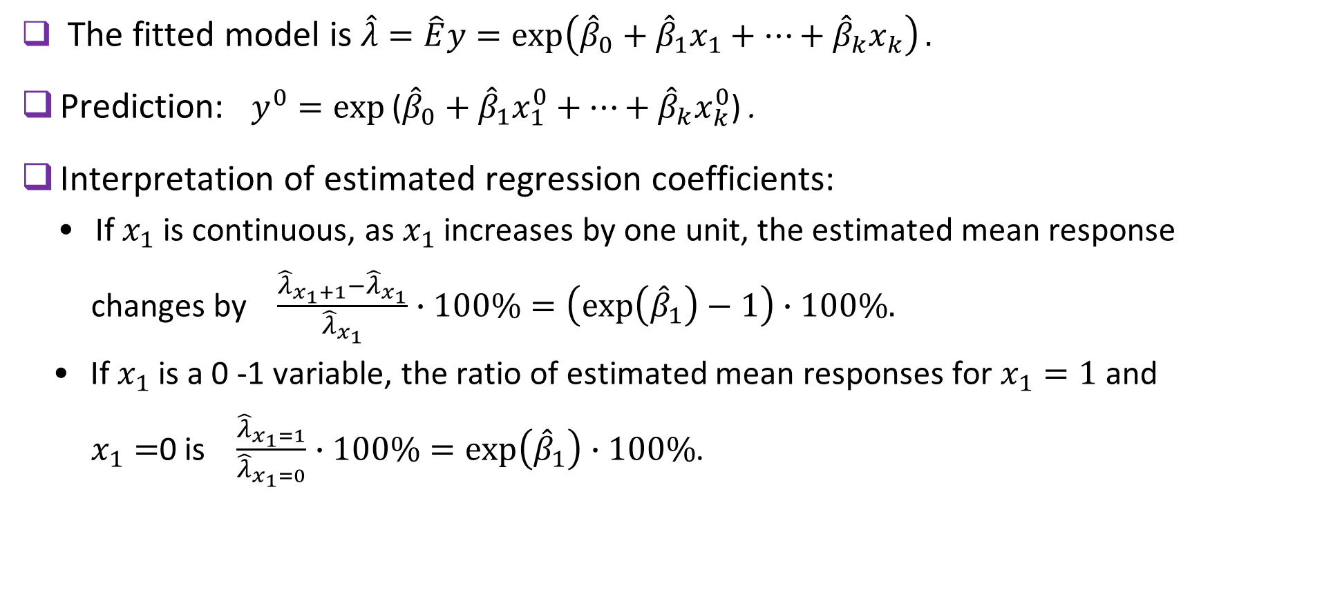
POISSON REGRESSION MODEL: THEORY (CONT.)
The fitted model is $\hat{λ}=\hat{E}y=\exp\left({\hat{β}}_{0}+{\hat{β}}_{1}x_{1}+…+{\hat{β}}_{k}x_{k}\right).$
Prediction: $y^{0}=\exp{\text{(}{\hat{β}}_{0}+{\hat{β}}_{1}x_{1}^{0}+…+{\hat{β}}_{k}x_{k}^{0}\text{)}}$ .
Interpretation of estimated regression coefficients:
• If $x_{1}$ is continuous, as $x_{1}$ increases by one unit, the estimated mean response
changes by $\frac{{\hat{λ}}_{x_{1}+1}−{\hat{λ}}_{x_{1}}}{{\hat{λ}}_{x_{1}}}∙100\%=\left(\exp\left({\hat{β}}_{1}\right)−1\right)∙100\%.$
• If $x_{1}$ is a 0 -1 variable, the ratio of estimated mean responses for $x_{1}=1$ and
$x_{1}=$0 is $\frac{{\hat{λ}}_{x_{1}=1}}{{\hat{λ}}_{x_{1}=0}}∙100\%=\exp\left({\hat{β}}_{1}\right)∙100\%$.
45

Slide 46
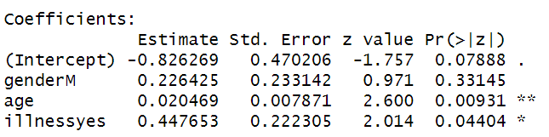
EXAMPLE: POISSON REGRESSION
POISSON REGRESSION MODEL: EXAMPLE
Number of days of hospital stay was recorded for 45 patients along with their gender, age, and history of chronical cardiac illness. The data are here.
We fit the Poisson regression model.
hospitalstay.data<- read.csv(file="./PoissonExampleData.csv", header=TRUE, sep=",")
summary(fitted.model<- glm(days ~ gender + age + illness, data=hospitalstay.data, family=poisson(link=log)))
46

Slide 47
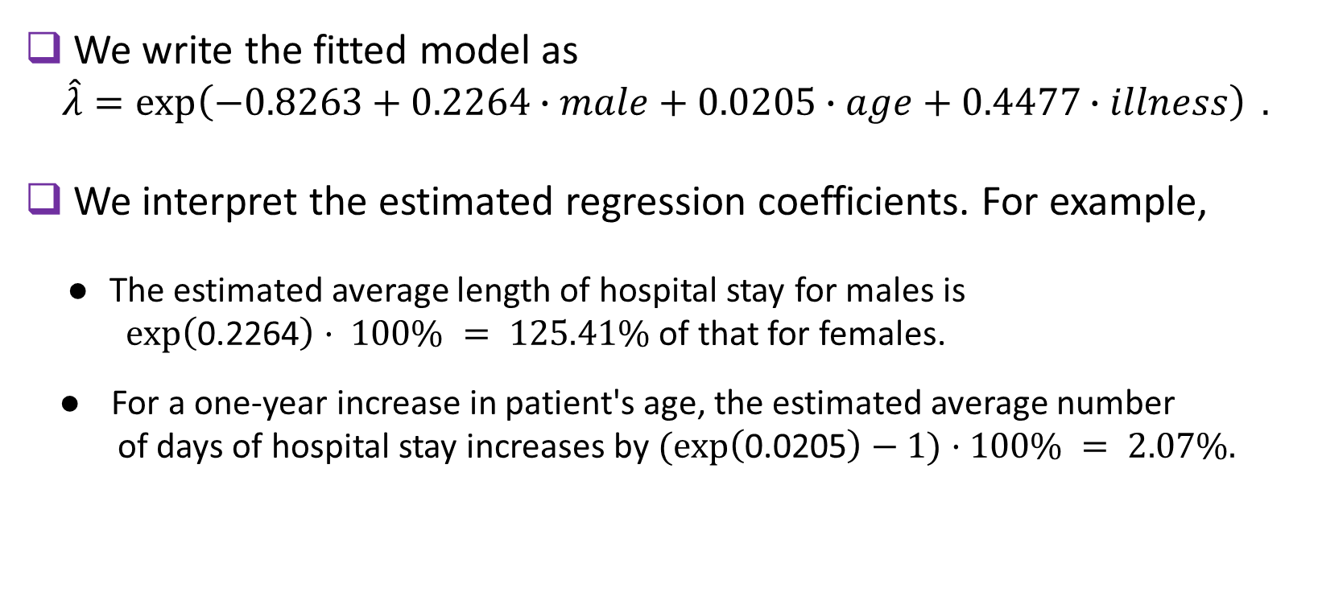
POISSON REGRESSION example continues
POISSON REGRESSION MODEL: EXAMPLE (CONT.)
We write the fitted model as
$$\hat{λ}=\exp\left(−0.8263+0.2264∙male+0.0205∙age+0.4477∙illness\right) .$$
We interpret the estimated regression coefficients. For example,
● The estimated average length of hospital stay for males is
$\exp\left(\text{0.2264}\right)· 100\% = 125.41\%$of that for females.
● For a one-year increase in patient's age, the estimated average number
of days of hospital stay increases by $(\exp\left(\text{0.0205}\right)−1)·100\% = 2.07\%.$
47

Slide 48
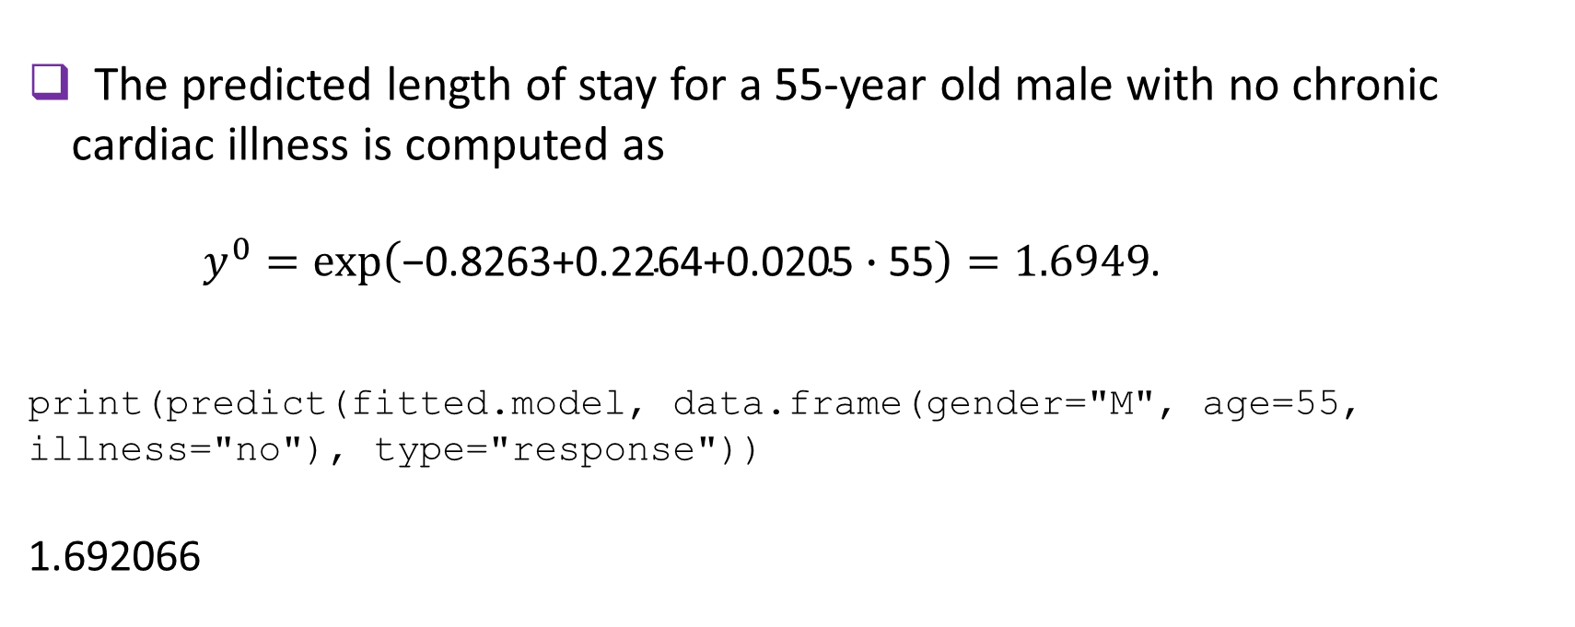
POISSON REGRESSION example continues
POISSON REGRESSION MODEL: EXAMPLE (CONT.)
The predicted length of stay for a 55-year old male with no chronic cardiac illness is computed as
$y^{0}=\exp\left(\text{−0.8263+0.2264+0.0205}∙\text{55}\right)=1.6949$.
print(predict(fitted.model, data.frame(gender="M", age=55, illness="no"), type="response"))
1.692066
48

Slide 49
POISSON REGRESSION example continues
POISSON REGRESSION MODEL: EXERCISE
A large automobile insurance company is studying the relation
between the total number of auto accidents (including minor) that
a policyholder had caused, and the policyholder's gender, age, and total number of miles driven (in thousands). The data for 45 randomly chosen policyholders are given here.
Write down the fitted Poisson regression model.
Interpret estimated regression coefficients.
(3) Give a predicted value of the total number of auto accidents caused
by a 35-year-old woman who has driven a total of one hundred
thousand miles.
49

Slide 50
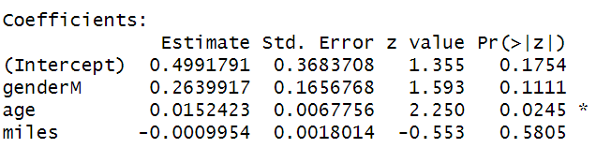
POISSON REGRESSION example continues
POISSON REGRESSION MODEL: EXERCISE SOLUTION
We fit the Poisson regression model
insurance.data<- read.csv(file="./PoissonExerciseData.csv", header=TRUE, sep=",")
summary(fitted.model<- glm(accidents ~ gender + age + miles, data=insurance.data, family=poisson(link=log)))
50

Slide 51
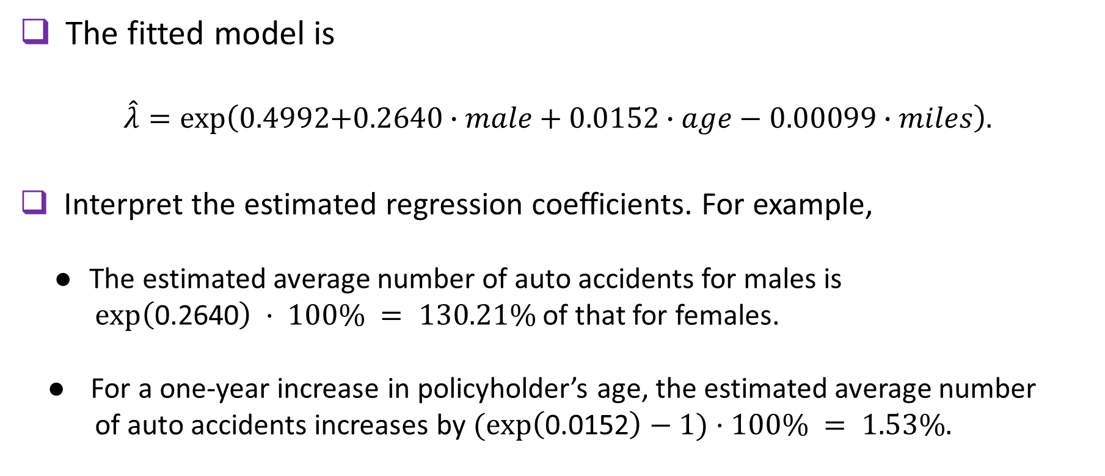
POISSON REGRESSION example continues
POISSON REGRESSION MODEL: EXERCISE SOLUTION (CONT.)
The fitted model is
$\hat{λ}=\exp\left(\text{0.4992+0.2640}∙male \text{+ 0.0152}∙age−0.00099∙miles\right)$.
Interpret the estimated regression coefficients. For example,
● The estimated average number of auto accidents for males is
$\exp\left(\text{0.2640}\right) · 100\% = 130.21\%$of that for females.
● For a one-year increase in policyholder’s age, the estimated average number
of auto accidents increases by $(\exp\left(\text{0.0152}\right)−1)·100\% = 1.53\%.$
51

Slide 52
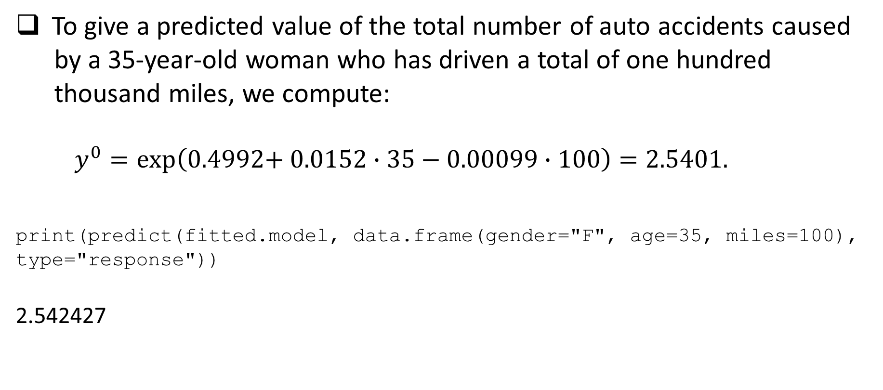
POISSON REGRESSION example continues
POISSON REGRESSION MODEL: EXERCISE SOLUTION (CONT.)
To give a predicted value of the total number of auto accidents caused
by a 35-year-old woman who has driven a total of one hundred
thousand miles, we compute:
$y^{0}=\exp\left(\text{0.4992+ 0.0152}∙\text{35}−0.00099∙100\right)=2.5401.$
print(predict(fitted.model, data.frame(gender="F", age=35, miles=100), type="response"))
2.542427
52

Slide 53
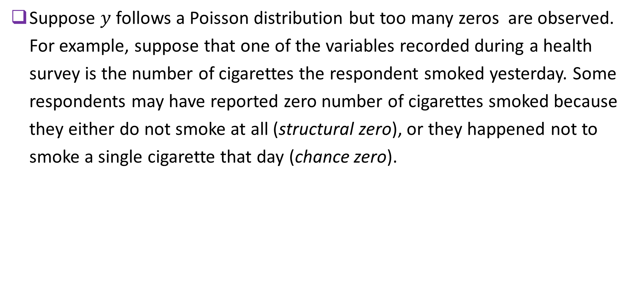
ZERO-INFLATED POISSON REGRESSION: THEORY
Suppose $y$ follows a Poisson distribution but too many zeros are observed. For example, suppose that one of the variables recorded during a health survey is the number of cigarettes the respondent smoked yesterday. Some respondents may have reported zero number of cigarettes smoked because they either do not smoke at all (structural zero), or they happened not to smoke a single cigarette that day (chance zero).
53

Slide 54
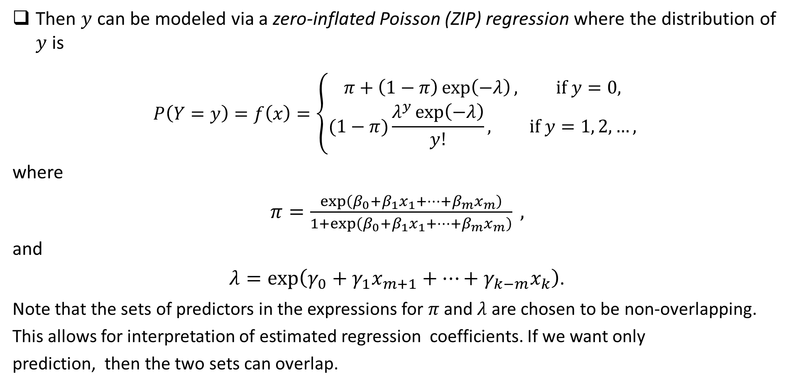
ZERO-INFLATED POISSON REGRESSION: THEORY (CONT.)
Then $y$ can be modeled via a zero-inflated Poisson (ZIP) regression where the distribution of $y$ is
$$P\left(Y=y\right)=f\left(x\right)=\left\{\begin{aligned}π+\left(1−π\right)\exp\left(−λ\right), if y=0, \\ &(1−π)\frac{λ^{y}\exp\left(−λ\right)}{y!}, if y=1, 2, …,\end{aligned}\right.$$
where
$π=\frac{\exp\left(β_{0}+β_{1}x_{1}+…+β_{m}x_{m}\right)}{1+\exp\left(β_{0}+β_{1}x_{1}+…+β_{m}x_{m}\right)} ,$
and
$λ=\exp\left(γ_{0}+γ_{1}x_{m+1}+…+γ_{k−m}x_{k}\right)$.
Note that the sets of predictors in the expressions for $π$and $λ$ are chosen to be non-overlapping.
This allows for interpretation of estimated regression coefficients. If we want only
prediction, then the two sets can overlap.
54

Slide 55
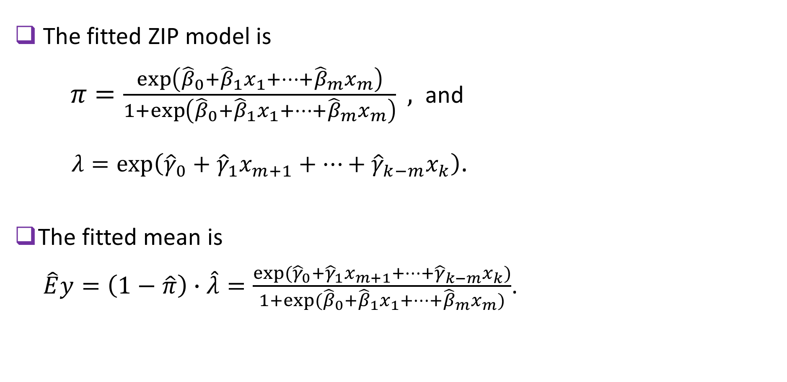
ZERO-INFLATED POISSON REGRESSION: THEORY (CONT.)
The fitted ZIP model is
$π=\frac{\exp\left({\hat{β}}_{0}+{\hat{β}}_{1}x_{1}+…+{\hat{β}}_{m}x_{m}\right)}{1+\exp\left({\hat{β}}_{0}+{\hat{β}}_{1}x_{1}+…+{\hat{β}}_{m}x_{m}\right)} ,$ and
$λ=\exp\left({\hat{γ}}_{0}+{\hat{γ}}_{1}x_{m+1}+…+{\hat{γ}}_{k−m}x_{k}\right)$.
The fitted mean is
$\hat{E}y=\left(1−\hat{π}\right)∙\hat{λ}=\frac{exp⁡({\hat{γ}}_{0}+{\hat{γ}}_{1}x_{m+1}+…+{\hat{γ}}_{k−m}x_{k})}{1+exp⁡({\hat{β}}_{0}+{\hat{β}}_{1}x_{1}+…+{\hat{β}}_{m}x_{m})}$.
55

Slide 56
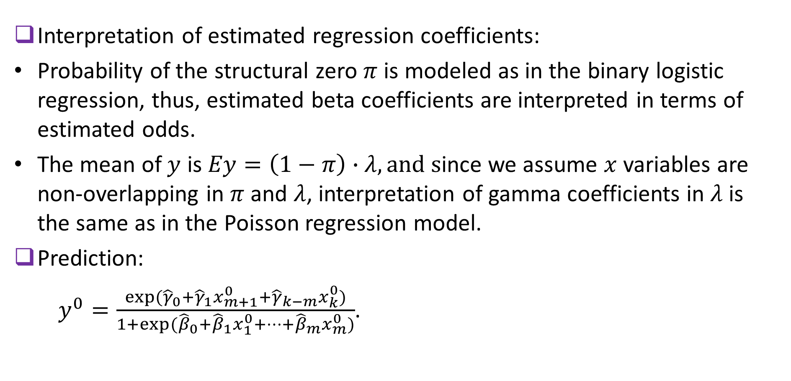
ZERO-INFLATED POISSON REGRESSION: THEORY (CONT.)
Interpretation of estimated regression coefficients:
Probability of the structural zero $π$ is modeled as in the binary logistic regression, thus, estimated beta coefficients are interpreted in terms of estimated odds.
The mean of $y$ is $Ey=\left(1−π\right)∙λ, and s$ince we assume $x$variables are non-overlapping in $π$ and $λ$, interpretation of gamma coefficients in $λ$ is the same as in the Poisson regression model.
Prediction:
$y^{0}=\frac{exp⁡({\hat{γ}}_{0}+{\hat{γ}}_{1}x_{m+1}^{0}+{\hat{γ}}_{k−m}x_{k}^{0})}{1+exp⁡({\hat{β}}_{0}+{\hat{β}}_{1}x_{1}^{0}+…+{\hat{β}}_{m}x_{m}^{0})}$.
56

Slide 57
EXAMPLE: zero-INFLATED POISSON REGRESSION
ZERO-INFLATED POISSON REGRESSION: EXAMPLE
A health survey has been administered to a random sample of 40 people aged between 25 and 50. Their gender, self-reported health condition (excellent or good), age, and the number of cigarettes they smoked yesterday were recorded. The data set is here.
Since those respondents who don't smoke were included in the survey, it is expected that the number of cigarettes smoked would have a Poisson distribution with an inflated number of zeros.
57

Slide 58
zero-INFLATED POISSON REGRESSION example continues
ZERO-INFLATED POISSON REGRESSION: EXAMPLE (CONT.)
We fit a ZIP model where, for example, health condition is used as the predictor of structural zero, while gender and age are the count model predictors.
smoking.data<- read.csv(file="./ZIPExampleData.csv", header=TRUE, sep=",")
library(pscl)
summary(fitted.model<- zeroinfl(cigarettes ~ gender + age | health, data=smoking.data))
58

Slide 59
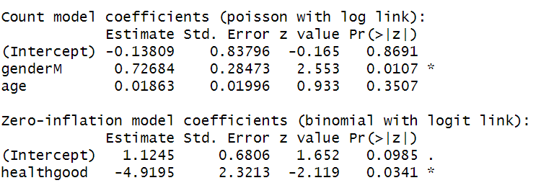
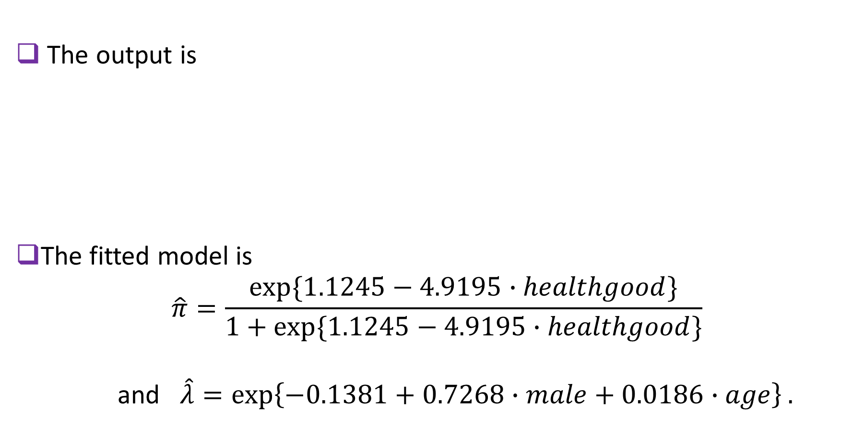
zero-INFLATED POISSON REGRESSION example continues
ZERO-INFLATED POISSON REGRESSION: EXAMPLE (CONT.)
The output is
The fitted model is
$$\hat{π}=\frac{exp⁡\{1.1245−4.9195∙healthgood\}}{1+exp⁡\{1.1245−4.9195∙healthgood\}}$$
and $\hat{λ}=\exp\left\{−0.1381+0.7268∙male+0.0186∙age\right\}.$
59

Slide 60
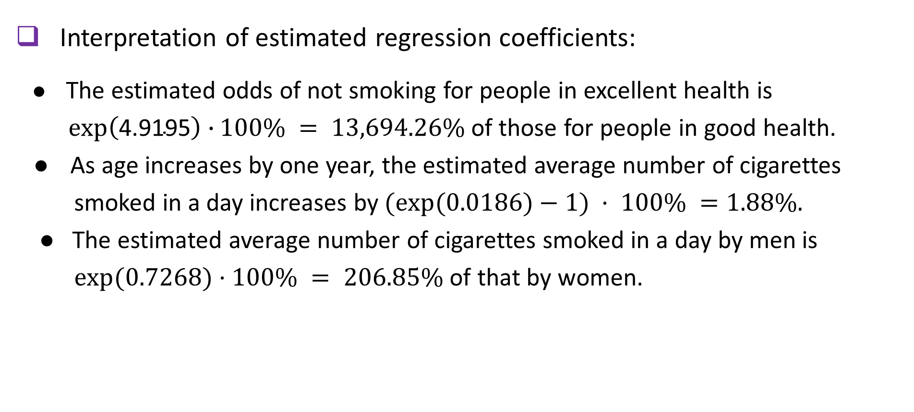
ZERO-INFLATED POISSON REGRESSION: EXAMPLE (CONT.)
Interpretation of estimated regression coefficients:
● The estimated odds of not smoking for people in excellent health is
$\exp\left(\text{4.9195}\right)∙100\% = 13,694.26\%$of those for people in good health.
● As age increases by one year, the estimated average number of cigarettes
smoked in a day increases by $(exp⁡(0.0186)−1) · 100\% =1.88\%.$
● The estimated average number of cigarettes smoked in a day by men is
$exp⁡(0.7268)·100\% = 206.85\%$of that by women.
60

Slide 61

ZERO-INFLATED POISSON REGRESSION: EXAMPLE (CONT.)
The predicted number of cigarettes smoked per day by a 50-year old male
who is in good health is found as
$$y^{0}=\frac{exp⁡(−0.1381+0.7268+0.0186∙50)}{1+exp⁡(1.1245−4.9195)}=4.4659.$$
print(predict(fitted.model, data.frame(gender="M", health="good", age=50)))
4.473327
61

Slide 62
ZERO-INFLATED POISSON REGRESSION: EXERCISE
Thirty five patients in a large hospital were randomly chosen for a survey. The variables recorded were patient's BMI, age, gender, indicator of current smoking, and the number of mild to severe asthma attacks in the past three months. The data are here.
Argue that a ZIP model is appropriate to model the number of asthma attacks.
Give the fitted model.
Interpret estimated regression coefficients.
Calculate the predicted value for the number of asthma attacks for a male patient,
aged 60, whose BMI is 21.2, and who is currently a smoker.
62

Slide 63
ZERO-INFLATED POISSON REGRESSION: EXERCISE SOLUTION
When no asthma attacked are observed in a patient, it could be a structural zero (the person never had an asthma attack) or a chance zero (the person happened not to have a single attack in the past three months).
Fit the ZIP model.
health.data<- read.csv(file="./ZIPExerciseData.csv", header = TRUE,
sep=",")
library(pscl)
summary(fitted.model<- zeroinfl(attacks ~ BMI + age + gender | smoking, data=health.data))
63

Slide 64


ZERO-INFLATED POISSON REGRESSION: EXERCISE SOLUTION (CONT.)
The output is
The fitted model looks like this: $\hat{π}=\frac{\exp\left(−0.8700−9.3323∙smoking\right)}{1+\exp\left(−0.8700−9.3323∙smoking\right)} ,$
and $\hat{λ}=\exp\left(2.2288−0.0954∙BMI+0.0118∙age+0.7161∙male\right).$
64

Slide 65

ZERO-INFLATED POISSON REGRESSION: EXERCISE SOLUTION (CONT.)
Estimated regression coefficients yield the following interpretation (for example):
$$\hat{π}=\frac{\exp\left(−0.8700−9.3323∙smoking\right)}{1+\exp\left(−0.8700−9.3323∙smoking\right)},$$
and $\hat{λ}=\exp\left(2.2288−0.0954∙BMI+0.0118∙age+0.7161∙male\right).$
● The estimated odds of not having asthma attacks for people in who smoke is
$exp⁡(−9.3323)· 100\% = 0.009\%$of those for people who don’t smoke.
● As BMI increases by one point, the estimated average number of asthma
attacks changes by $(exp⁡(−0.0954)−1) · 100\% =−9.10\%,$that is,
decreases by 9.1%.
● The estimated average number of asthma attacks for men is $exp⁡(0.7161)·100\%$
$= 204.64 \%$ of that for women.
65

Slide 66

ZERO-INFLATED POISSON REGRESSION: EXERCISE SOLUTION (CONT.)
To predict the number of asthma attacks for a male patient, aged 60, whose BMI is 21.2, and who is currently a smoker, compute
$$y^{0}=\frac{\exp\left(2.2288−0.0954∙21.2+0.0118∙60+0.7161\right)}{1+exp⁡\{−0.8700−9.3323\}}=5.1058.$$
print(predict(fitted.model, data.frame(BMI=21.2, age=60, gender="M", smoking="yes")))
5.112566
66

Slide 67

BETA REGRESSION: THEORY
When the response variable $y$ assumes real values between 0 and 1, a beta regression is appropriate. The distribution of $y$ is assume to have density
$$f\left(y\right)=\frac{y^{μφ−1}{(1−y)}^{\left(1−μ\right)φ−1}}{B\left(μφ, \left(1−μ\right)φ\right)}, 0<y<1,$$
where the location parameter
$$μ=\frac{\exp\left(β_{0}+β_{1}x_{1}+…+β_{k}x_{k}\right)}{1+\exp\left(β_{0}+β_{1}x_{1}+…+β_{k}x_{k}\right)},$$
and $φ$is the dispersion parameter. The mean of $y$ is $μ$ and variance $\frac{μ\left(1−μ\right)}{φ}.$
The fitted model is $\hat{μ}=\hat{E}\left(y\right)=\frac{exp⁡({\hat{β}}_{0}+{\hat{β}}_{1}x_{1}+…+{\hat{β}}_{k}x_{k})}{1+exp⁡({\hat{β}}_{0}+{\hat{β}}_{1}x_{1}+…+{\hat{β}}_{k}x_{k})}$ and $\hat{φ}.$
67

Slide 68

BETA REGRESSION: THEORY (CONT.)
Interpretation of estimated regression coefficients.
Note that $\frac{\hat{μ}}{1−\hat{μ}}=exp⁡({\hat{β}}_{0}+{\hat{β}}_{1}x_{1}+…+{\hat{β}}_{k}x_{k})$. Therefore, estimated regression
coefficients can be interpreted as follows:
● For a one-unit increase in a numerical predictor $x_{1}$, the percent change
in the estimated ratio $\frac{\hat{μ}}{1−\hat{μ}}=\frac{\hat{E}(y)}{1−\hat{E}(y)}$ is $\left(\exp\left({\hat{β}}_{1}\right)−1\right)∙100\%$, controlling for
the other predictors.
● If $x_{1}$is a 0-1 variable, then $\exp\left({\hat{β}}_{1}\right)∙100\% represents the percent$ratio $\frac{\hat{μ}}{1−\hat{μ}}$
for $x_{1}=1$and $x_{1}=0$, keeping the other predictors fixed.
68

Slide 69

BETA REGRESSION: THEORY (CONT.)
Prediction:
$y^{0}=\frac{\exp\left({\hat{β}}_{0}+{\hat{β}}_{1}x_{1}^{0}+…+{\hat{β}}_{k}x_{k}^{0}\right)}{1+\exp\left({\hat{β}}_{0}+{\hat{β}}_{1}x_{1}^{0}+…+{\hat{β}}_{k}x_{k}^{0}\right)}$.
69

Slide 70
BETA REGRESSION: EXAMPLE
A professor of Library and Information Science has collected a random sample of 28 libraries and recorded total number of books each library has (in thousands), number of card holders (in thousands), library location (urban or rural), number of books checked out during a one-month period, and number of books that were returned on-time. The professor has calculated the proportion of books returned on-time as the ratio between the number of books returned on-time and number of books checked out, and is interested in studying associations between this proportion and the three predictor variables. The data are here.
70

Slide 71


BETA REGRESSION: EXAMPLE (CONT.)
libraries.data<- read.csv(file="./BetaExampleData.csv", header=TRUE, sep=",")
We fit a beta regression model.
library(betareg)
summary(fitted.model<- betareg(propontime ~ nbooks + ncardholders + location, data=libraries.data, link="logit"))
71

Slide 72

BETA REGRESSION: EXAMPLE (CONT.)
The fitted model has
$\hat{E}(prop ontime)=\frac{\exp\left(−0.2058+0.0262∙nbooks+0.0449∙ncardholders+0.5236∙urban\right)}{1+\exp\left(−0.2058+0.0262∙nbooks+0.0449∙ncardholders+0.5236∙urban\right)}$,
and $\hat{φ}=$20.648.
Interpretation of the estimated regression coefficients. For example,
● As the number of books increases by one thousand, the estimated ratio of the
mean proportion of books returned on-time and the mean proportion of books
not returned on-time increases by $\left(\exp\left(0.0262\right)−1\right)∙100\%=2.64\%.$
● This ratio for urban libraries is $\exp\left(0.5236\right)∙100\%=168.81\%$ of that for
rural libraries.
72

Slide 73

BETA REGRESSION: EXAMPLE (CONT.)
Suppose we would like to predict the proportion of books that are returned on
time for a library in a rural area with 15,000 books and 2,500 card holders.
We calculate
${prop ontime}^{0}=\frac{\exp\left(−0.2058+0.0262∙15+0.0449∙2.5\right)}{1+\exp\left(−0.2058+0.0262∙15+0.0449∙2.5\right)}=\text{0}\text{.5}\text{7448}$.
print(predict(fitted.model, data.frame(nbooks=15, ncardholders=2.5, location="rural")))
0.5744721
73

Slide 74
BETA REGRESSION: EXERCISE
Ornithologists have collected data on migration of birds. They ringed 19 flocks of migratory birds prior to migration, and recorded for each flock the number of ringed birds, average mass (in kg), and average wingspan (in cm). The ringed flocks were observed later at the wintering grounds and the number of successfully migrated birds were counted. Proportion of successfully migrated birds was computed. The distances traveled (in Kkm) were also observed. The data are presented here.
Fit a beta regression to model the proportion of successfully migrated
birds (compute this variable first). Write down the fitted model.
(2) Interpret estimated regression coefficients.
Predict the number of birds that successfully reach the winter grounds for a flock of
birds with average mass of 600 g, average wingspan of 65 cm, that travel a distance of
1650 km, and typically travel in flocks of about 70 birds.
74

Slide 75


BETA REGRESSION: EXERCISE SOLUTION
We fit the beta regression.
birds.data<- read.csv(file="./BetaExerciseData.csv", header=TRUE,
sep=",")
library(betareg)
summary(fitted.model<- betareg(propmigrated ~ mass + wingspan + distance,
data = birds.data, link="logit"))
75

Slide 76

BETA REGRESSION: EXERCISE SOLUTION (CONT.)
The fitted model is
$\hat{E}(prop migrated )=\frac{\exp\left(2.7830−0.0015∙mass+0.0004∙wingspan−1.3186∙distance\right)}{1+\exp\left(2.7830−0.0015∙mass+0.0004∙wingspan−1.3186∙distance\right)}$,
and $\hat{φ}=$4.173.
Interpretation of the estimated regression coefficients. For example,
● As the wing span increases by 1 cm, the estimated ratio of the mean
proportion of successfully migrated birds and those who didn’t succeed
increases by $\left(\exp\left(0.0004\right)−1\right)∙100\%=0.04\%.$
● If the distance increases by one thousand km, his ratio changes by
$\left(\exp\left(−1.3186\right)−1\right)∙100\%=−73.25\%,$ that is, decreases by 73.25%.
76

Slide 77

BETA REGRESSION: EXERCISE SOLUTION (CONT.)
Predict the number of birds that successfully reach the winter grounds for a flock of birds with average mass of 600 g, average wingspan of 65 cm, that travel a distance of 1650 km, and typically travel in flocks of about 70 birds. We compute
${prop migrated}^{0}∙70=\frac{\exp\left(2.7830−0.0015∙0.6+0.0004∙65−1.3186∙1.65\right)}{1+\exp\left(2.7830−0.0015∙0.6+0.0004∙65−1.3186∙1.65\right)}∙70$
=$\left(0.6530\right)\left(70\right)=$45.71.
print(70*predict(fitted.model, data.frame(mass=0.6, wingspan=65, distance=1.65)))
45.76414
77

Slide 78

LONGITUDINAL NORMAL REGRESSION: THEORY
Suppose data are collected longitudinally at times $t_{1}, …, t_{p}.$ For each individual $i,$
$i=1, …, n,$at time $t_{j}, j=1, …, p,$the observations are $x_{1ij}, …, x_{kij}, and y_{ij}.$
The random slope and intercept model for a normally distributed response
variable is defined as
$y_{ij}=β_{0}+β_{1}x_{1ij}+…+β_{k}x_{kij}+β_{k+1}t_{j}+u_{1i}+u_{2i}t_{j}+ε_{ij}$
where $u_{1i}$’s are independent $N(0, σ_{u_{1}}^{2})$ random intercepts, $u_{2i}$’s are independent
$N(0, σ_{u_{2}}^{2})$ random slopes, and $ε_{ij}$’s are independent $N\left(0, σ^{2}\right)$ random errors that
are also independent of $u_{1i}$’s and $u_{2i}$’s. It is assumed that $Cov\left(u_{1i}\text{ , }u_{2i}\right)= σ_{u_{1}u_{2}}$,
and $Cov\left(u_{1i}\text{ , }u_{2i′}\right)=0$ for $i≠i^{′}.$ Another name for this model is mixed-effects model because it comprises variables with fixed effects (betas) and random effects (random slope and intercept).
78

Slide 79

LONGITUDINAL NORMAL REGRESSION: THEORY (CONT.)
It can be shown that $Cov\left(y_{ij}, y_{i^{′}j′}\right)=0, i≠i^{′},$ meaning that the responses for different individuals are uncorrelated for any time points. It can also be shown that responses between different time points the same individual may be correlated, since $Cov\left(y_{ij}, y_{ij′}\right)=σ_{u_{1}}^{2}+σ_{u_{1}u_{2}}\left(t_{j}+t_{j′}\right)+σ_{u_{2}}^{2}t_{j}t_{j′}$, for $j≠j^{′}.$ In addition, it can be verified that the response variable $y_{ij}$ is normally distributed with the mean
$$E\left(y_{ij}\right)=β_{0}+β_{1}x_{1}+…+β_{k}x_{k}+β_{k+1}t$$
and variance $Var\left(y_{ij}\right)=σ_{u_{1}}^{2}+2σ_{u_{1}u_{2}}t_{j}+σ_{u_{2}}^{2}t_{j}^{2}+σ^{2}.$
79

Slide 80

LONGITUDINAL NORMAL REGRESSION: THEORY (CONT.)
The fitted model is
$\hat{E}y={\hat{β}}_{0}+{\hat{β}}_{1}x_{1}+…+{\hat{β}}_{k}x_{k}+{\hat{β}}_{k+1}t$.
Estimated regression coefficients are interpreted the same as in a general
linear regression model (for normal response).
Likewise, predicted response is computed the same way as in a general
linear regression model, that is,
$y^{0}={\hat{β}}_{0}+{\hat{β}}_{1}x_{1}^{0}+…+{\hat{β}}_{k}x_{k}^{0}+{\hat{β}}_{k+1}t^{0}$.
80

Slide 81
LONGITUDINAL NORMAL REGRESSION: EXAMPLE
In a clinic, doctors are testing a certain cholesterol lowering medication.
Patients’ gender and age at the beginning of the study are recorded for
27 patients. The low-density lipoprotein (LDL) cholesterol levels are
measured in all the patients at the baseline, and then at 6-, 9-, and 24-
month follow-up visits. The data are here.
We read in the data set.
cholesterol.data<- read.csv(file="./LongitudinalNormalExampleData.csv",
header=TRUE, sep=",")
81

Slide 82
LONGITUDINAL NORMAL REGRESSION: EXAMPLE (CONT.)
We create a long-form data set and a numeric variable for time.
library(reshape2)
longform.data<- melt(cholesterol.data, id.vars=c("id", "gender", "age"),
variable.name = "LDLmonth", value.name="LDL")
#creating numeric variable for time
month<- ifelse(longform.data$LDLmonth=="LDL0", 0,
ifelse(longform.data$LDLmonth=="LDL6", 6,
ifelse(longform.data$LDLmonth=="LDL9",9,24)))
The output is here.
82

Slide 83

LONGITUDINAL NORMAL REGRESSION: EXAMPLE (CONT.)
We plot a histogram to convince ourselves that LDL is a normally distributed variable.
library(rcompanion)
plotNormalHistogram(longform.data$LDL)
83

Slide 84

LONGITUDINAL NORMAL REGRESSION: EXAMPLE (CONT.)
We fit a random slope and intercept model.
library(nlme)
summary(fitted.model<- lme(LDL ~ gender+age+month,
random =~ 1+month|id, data=longform.data))
84

Slide 85

LONGITUDINAL NORMAL REGRESSION: EXAMPLE (CONT.)
The fitted model is
$$\hat{E}(LDL)=94.8267−29.8106∙male+0.9203∙age−1.0957∙month.$$
Interpretation of the estimated regression coefficients. For example,
● As age increases by one year, the estimated mean LDL increases by
0.9203 points.
● The estimated average LDL for males is 29.8106 points lower than
that for females.
85

Slide 86

LONGITUDINAL NORMAL REGRESSION: EXAMPLE (CONT.)
To predict the LDL level at 3 months for a 48-year-old female patient, we compute ${LDL}^{0}=94.8267+0.9203∙48−1.0957∙3=135.7141.$
print(predict(fitted.model, data.frame(gender=0, age=48, month=3), level=0))
135.7156
86

Slide 87
LONGITUDINAL NORMAL REGRESSION: EXERCISE
Measurements were taken on 20 people involved in a physical fitness course. The data contain participants’ gender, age, oxygen intake (in ml per kg body weight per minute), run time (time to run 1 mile, in minutes), and pulse (average heart rate while running). The running was done under three different conditions: the first one on a treadmill, the second one on an indoor running track, and the third one on an outdoor running track.
Note that the data were collected not over time but under three different conditions. We call this type of data not longitudinal, but repeated measures. Random slope and intercept model still applies.
87

Slide 88
LONGITUDINAL NORMAL REGRESSION: EXERCISE (CONT.)
(1) Study the code that creates a long-form data set and defines a numeric variable with condition (1=treadmill, 2=indoor track, or 3=outdoor track).
(2) Plot a histogram for pulse to see that the underlying distribution is normal.
(3) Fit a random slope and intercept model, regressing pulse of the rest of the variables. State the fitted model.
(4) Interpret estimated regression coefficients.
(5) Predict an average pulse for a 36-year-old woman who is running
on a treadmill, if her oxygen intake is 40.2 units, and her run time is 10.3
minutes per mile.
88

Slide 89

LONGITUDINAL NORMAL REGRESSION: EXERCISE SOLUTION
We plot the histogram for pulse.
library(rcompanion)
plotNormalHistogram(longform.data$pulse)
89

Slide 90

LONGITUDINAL NORMAL REGRESSION: EXERCISE SOLUTION (CONT.)
We fit the model.
library(nlme)
summary(fitted.model<- lme(pulse ~ gender + age + oxygen + runtime + condition, random =~ 1 + condition|id, control=lmeControl(opt="optim"), data=longform.data))
90

Slide 91

LONGITUDINAL NORMAL REGRESSION: EXERCISE SOLUTION (CONT.)
The fitted model is
$\hat{E}\left(pulse\right)=167.1870−0.3735∙male−0.6993∙age+0.0306∙oxygen$
$+1.9591∙runtime +0.7578∙condition$.
Interpretation of the estimated regression coefficients. For example,
● As age increases by one year, the estimated average pulse decreases by
0.6993 points.
● The estimated average pulse for males is 0.3735 points less than
that for females.
91

Slide 92

LONGITUDINAL NORMAL REGRESSION: EXERCISE SOLUTION (CONT.)
We predict an average pulse for a 36-year-old woman who is running
on a treadmill, if her oxygen intake is 40.2 units, and her run time is 10.3
minutes per mile. We calculate
$${pulse}^{0}=167.1870−0.6993∙36+0.0306∙40.2$$
$+1.9591∙10.3 +0.7578∙1=164.17885$.
print(predict(fitted.model, data.frame(gender=0, age=36, condition=1, oxygen=40.2, runtime=10.3), level=0))
$$\text{164.1766}$$
92

Slide 93

LONGITUDINAL LOGISTIC REGRESSION: THEORY
It is no extra work to run a random slope and intercept model for a generalized linear regression (for example, gamma, logistic, Poisson, or beta).
The model has the form
$$g\left(E\left(y\right)\right)=β_{0}+β_{1}x_{1}+…+β_{k}x_{k}+β_{k+1}t+u_{1}+u_{2}t$$
where $g(∙)$ is the link function that corresponds to the underlying distribution, $u_{1}\sim N(0, σ_{u_{1}}^{2})$ is a random intercept, $u_{2}\sim N(0, σ_{u_{2}}^{2})$ is a random slope, and $Cov\left(u_{1}\text{ , }u_{2}\right)= σ_{u_{1}u_{2}}$. Note: there is no random error $ε.$
The fitted model is $g\left(\hat{E}\left(y\right)\right)={\hat{β}}_{0}+{\hat{β}}_{1}x_{1}+…+{\hat{β}}_{k}x_{k}+{\hat{β}}_{k+1}t$.
93

Slide 94
LONGITUDINAL LOGISTIC REGRESSION: EXAMPLE
A pharmaceutical company conducted a dosage trial for a painkiller medication. Two dosages (A and B) were identified for a long-run safety check. An experiment was set up with 14 subjects in each of the two groups, taking dosages A and B, respectively. The goal of the experiment was to identify which dosage is less likely to cause side effects. The data set contains participants’ IDs, dosage (A or B), gender, and presence or absence of side effects (1=present, or 0=absent) at 1, 3, 7, and 16 weeks.
94

Slide 95
LONGITUDINAL LOGISTIC REGRESSION: EXAMPLE (CONT.)
We create a long-form data set and a time variable
dosages.data<- read.csv(file="./LongitudinalLogisticExampleData.csv", header=TRUE, sep=",")
#creating longform dataset and time variable
library(reshape2)
longform<- melt(dosages.data, id.vars=c("patid","dosage", "gender"), variable.name="weekn", value.name="effects")
week<- ifelse(longform$weekn=="week1",1,ifelse(longform$weekn=="week3",3,
ifelse(longform$weekn=="week7",7,16)))
95

Slide 96

LONGITUDINAL LOGISTIC REGRESSION: EXAMPLE (CONT.)
We run logistic regression model on the long-form data set.
library(lme4)
summary(fitted.model<- glmer(effects~dosage+gender+week+(1+week|patid), data=longform,family=binomial(link="logit")))
96

Slide 97

LONGITUDINAL LOGISTIC REGRESSION: EXAMPLE (CONT.)
The fitted model is
$\hat{P}(side effects)=\frac{\exp\left(−9.1020+4.6269∙dosage B+0.1295∙male+1.0423∙week\right)}{1+\exp\left(−9.1020+4.6269∙dosage B+0.1295∙male+1.0423∙week\right)}$.
Interpretation of the estimated regression coefficients is like in a logistic regression (in terms of odds in favor of side effects). Important observation: The estimated odds in favor of side effects for dosage B are $\exp\left\{4.6269\right\}∙100\%=$10219.68% of those for dosage A. The study conclusion is that dosage A outperforms dosage B.
97

Slide 98

LONGITUDINAL LOGISTIC REGRESSION: EXAMPLE (CONT.)
Suppose we want to predict the probability of a side effect occurring at week 7 for a woman taking dosage A. We compute
print(predict(fitted.model, data.frame(patid=29, dosage="A", gender="F", week=7), re.form=NA, type="response"))
0.1411383
$P^{0}(side effect)=\frac{\exp\left(−9.1020 +1.0423∙7\right)}{1+\exp\left(−9.1020 +1.0423∙7\right)}$=0.1411.
98

Slide 99
LONGITUDINAL POISSON REGRESSION: EXERCISE
A dermatologist tests a new ointment treatment for psoriasis. He administers the ointment to five patients, and keeps five patients as control. The control patients take a medication that is commonly prescribed against the disease. The doctor sees the patients next day, then after one week, two weeks, five weeks, and finally, after three months. He records the number of psoriatic patches that are visible on patients’ bodies. The data are here.
99

Slide 100
LONGITUDINAL POISSON REGRESSION: EXERCISE (CONT.)
(1) Study the code that creates a long-form data set and defines a numeric variable for time (in weeks).
(2) Fit a random slope and intercept model Poisson regression to model the number of psoriatic patches. State the fitted model.
(3) Interpret estimated regression coefficients.
(4) Predict the number of psoriatic patches for a patient in the treatment group at five weeks.
100

Slide 101

LONGITUDINAL POISSON REGRESSION: EXERCISE SOLUTION
We fit the model.
library(lme4)
summary(fitted.model<- glmer(npatches ~ group + weeks
+ (1 + weeks | patid), data=longform.data, family=poisson(link="log")))
101

Slide 102

LONGITUDINAL POISSON REGRESSION: EXERCISE SOLUTION (CONT.)
The fitted model is
$$\hat{E}\left(npatches\right)=\exp\left(2.4586+0.1914∙Tx−0.1568∙weeks\right).$$
Interpretation of the estimated coefficients:
● The estimated average number of psoriatic patches for patients in the
treatment group is $\exp\left(0.1914\right)∙100\%=121.09\%$ of that for patients in the
control group.
● As the time increases by one week, the estimated average number of psoriatic
patches changes by $\left(\exp\left(−0.1568\right)−1\right)∙100\%=−14.51\%,$ that is, decreases
by 14.51%.
102

Slide 103

LONGITUDINAL POISSON REGRESSION: EXERCISE SOLUTION (CONT.)
To predict the number of psoriatic patches for a patient in the treatment group at five weeks, we compute
${npatches}^{0}=\exp\left(2.4586+0.1914−0.1568∙5\right)=6.4624$.
print(predict(fitted.model, data.frame(patid=11, group="Tx", weeks=5), re.form=NA, type="response"))
6.462278
103

Slide 104
HIERARCHICAL REGRESSION FOR NORMAL RESPONSE: THEORY
IDEA: Suppose data are collected for school children. We cannot model all responses as completely independent from each other. We expect children within the same classroom (same teacher) to have correlated responses. Also, children within the same school will have correlated responses. So, we need our regression to be able model these dependences (at level 1 = school, level 2= classrooms within the same school, and level 3= children within the same classroom). This can be done with hierarchical regression model with three levels of hierarchy.
We will look at the case when we have several clusters, several individuals within each cluster, and longitudinally collected data for each individual.
104

Slide 105

HIERARCHICAL REGRESSION FOR NORMAL RESPONSE: THEORY (CONT.)
We model a normal response for individual $i$, at time $t_{j},$in cluster $m as$
$$y_{ijm}=β_{0}+β_{1}x_{1ijm}+…+β_{k}x_{kijm}+β_{k+1}t_{j}+u_{1im}+u_{2im}t_{j}$$
$$+τ_{1m}+τ_{2m}t_{j}+ε_{ijm}$$
where betas are fixed effects, and the other are random effects.
Fitted model is $\hat{E}y={\hat{β}}_{0}+{\hat{β}}_{1}x_{1}+…+{\hat{β}}_{k}x_{k}+{\hat{β}}_{k+1}t$.
Interpretation and prediction is done like in the general linear model.
105

Slide 106
HIERARCHICAL REGRESSION FOR NORMAL RESPONSE: EXAMPLE
Mothers and daughters from 24 families with signs of depression were invited for a study of efficacy of a new method of intensive psychotherapy. At the baseline, one- and three-month visits, the quality of life (QOL) questionnaire was filled out by each of the participant, and a QOL score was computed. Higher values of this score indicate better quality of life. Whether signs of depression were present was also recorded (1=present, or 0=absent). The study was done on mother-daughter dyads. This type of study is called familial or dyadic. The scores are logically expected to be correlated over time for each individual, and also members of the same family might have correlated responses. We fit a three-stage hierarchical model for these data.
106

Slide 107

HIERARCHICAL REGRESSION FOR NORMAL RESPONSE: EXAMPLE (CONT.)
We create a long-form data set and run the regression.
summary(fitted.model<- lmer(qol ~ relation + depression + visit
+ (1 + visit|family)+ (1 + visit|family:individual), control=lmerControl(calc.derivs = FALSE), data=longform.data))
107

Slide 108
HIERARCHICAL REGRESSION FOR NORMAL RESPONSE: EXERCISE
A team of school inspectors is studying scores on tests in English Language Arts (ELA), Mathematics, and Science and their relation to schools’ Academic Performance Index (API) and classroom size. Data on average classroom scores for five consecutive years at two schools are available. Note that the data are already in the long-form format.
Identify the three levels of hierarchy in this model.
Plot a histogram for score to confirm that it has normal distribution.
Fit a proper hierarchical regression to model scores.
108

Slide 109

HIERARCHICAL NORMAL REGRESSION: EXERCISE SOLUTION
The levels of hierarchy are: schools (level 1), subjects within school (level 2), and different years within each subject (level 3).
Plot a histogram for score to confirm that it has normal distribution.
library(rcompanion)
plotNormalHistogram(school$score)
109

Slide 110

HIERARCHICAL NORMAL REGRESSION: EXERCISE SOLUTION (CONT.)
Fit a proper hierarchical regression to model API.
library(lme4)
summary(fitted.model<- lmer(score ~ API + classsize + year
+ (1 + year|school) + (1 + year|school:subject), data=school))
110

Slide 111
THANK YOU!

